Slide 1
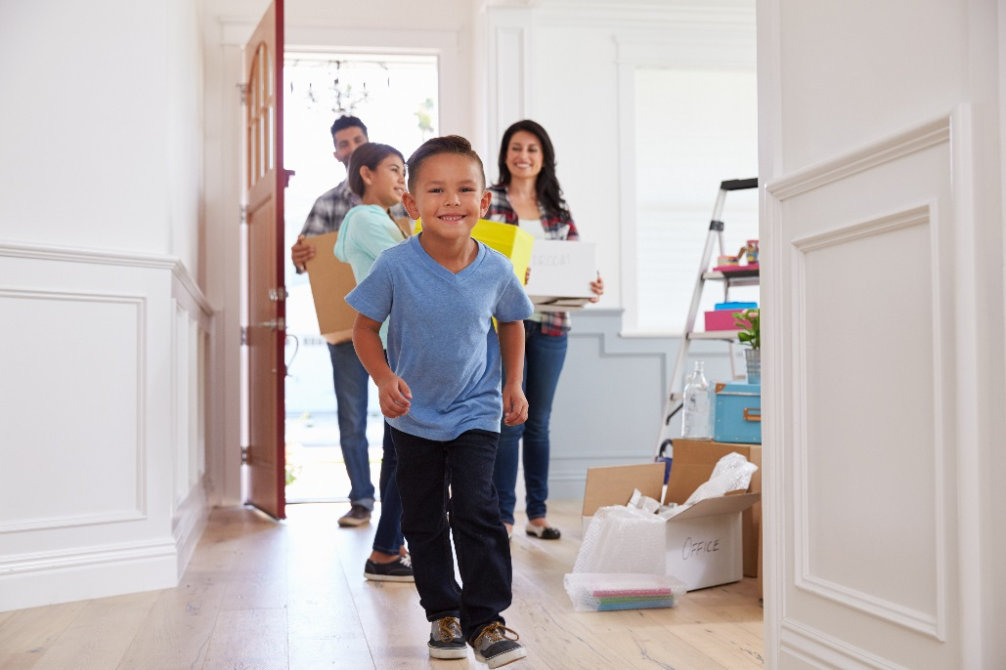
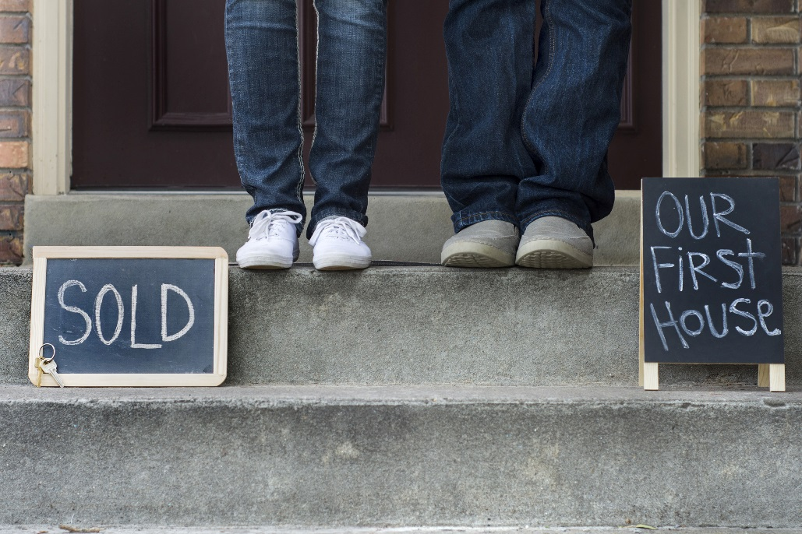
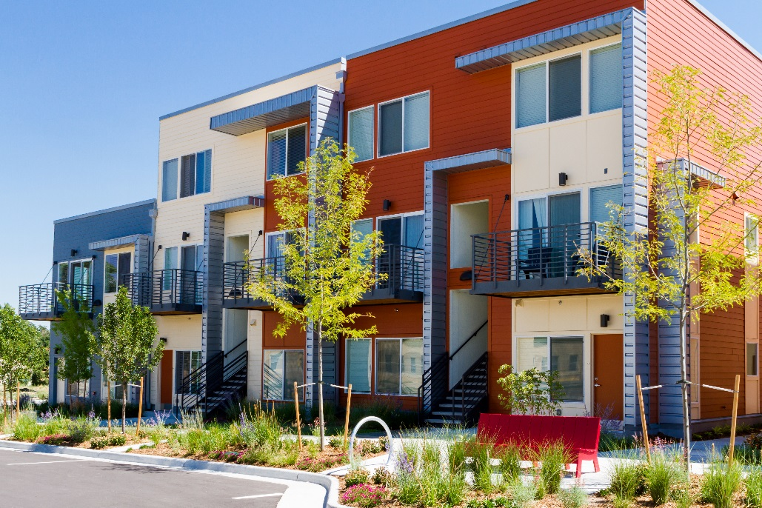
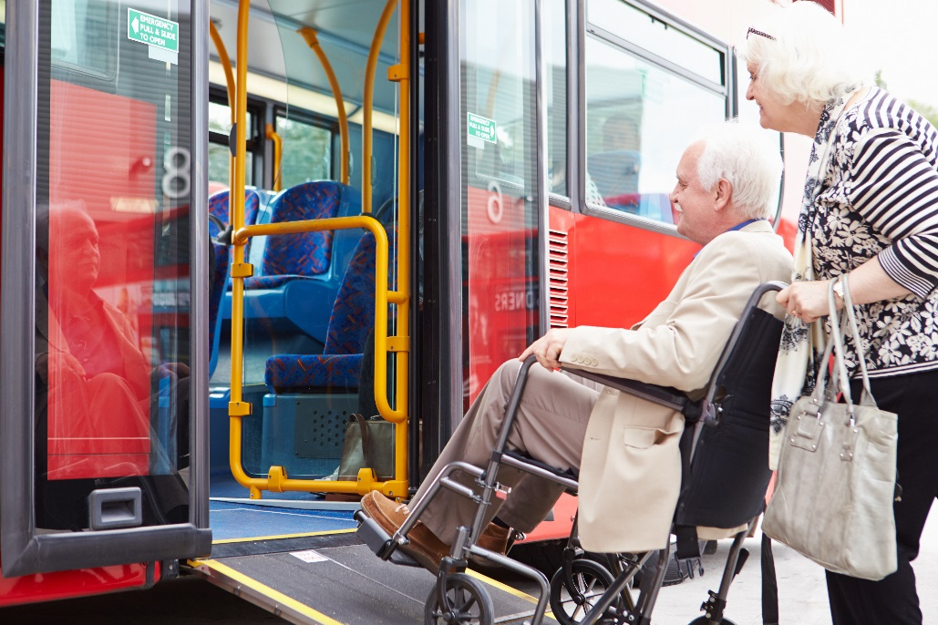
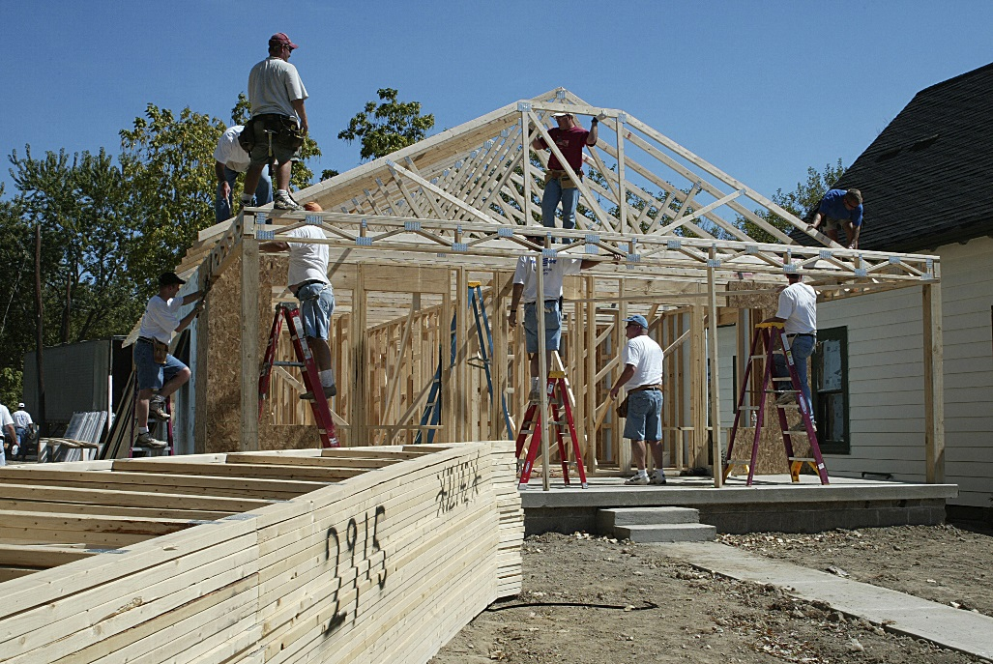
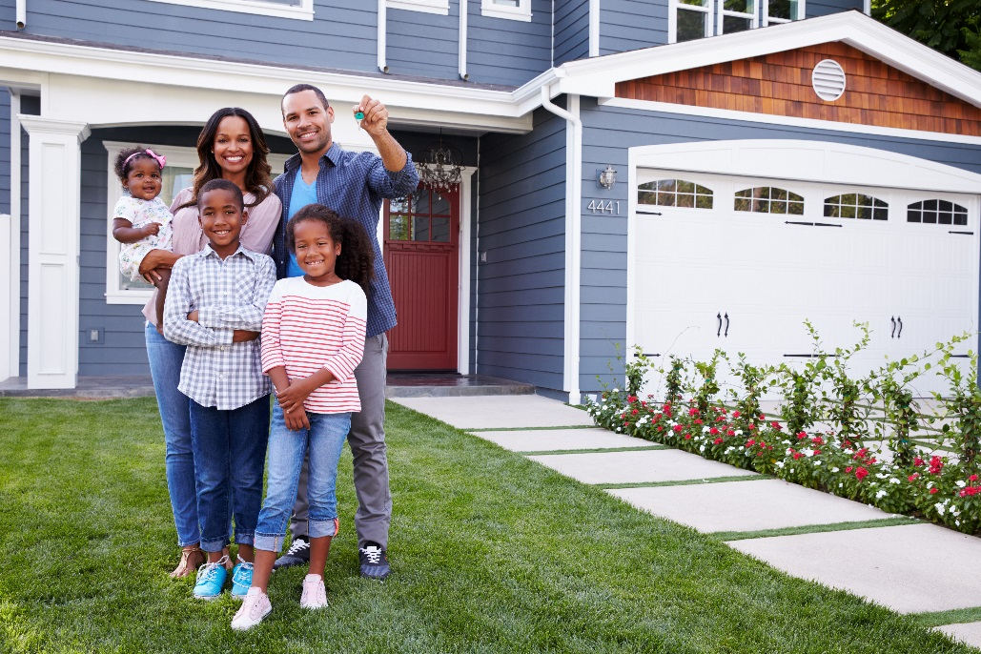
Community Needs Survey
To inform the Community Development Block Grant and HOME
5-year plan – look at how to prioritize our funds

Slide 2
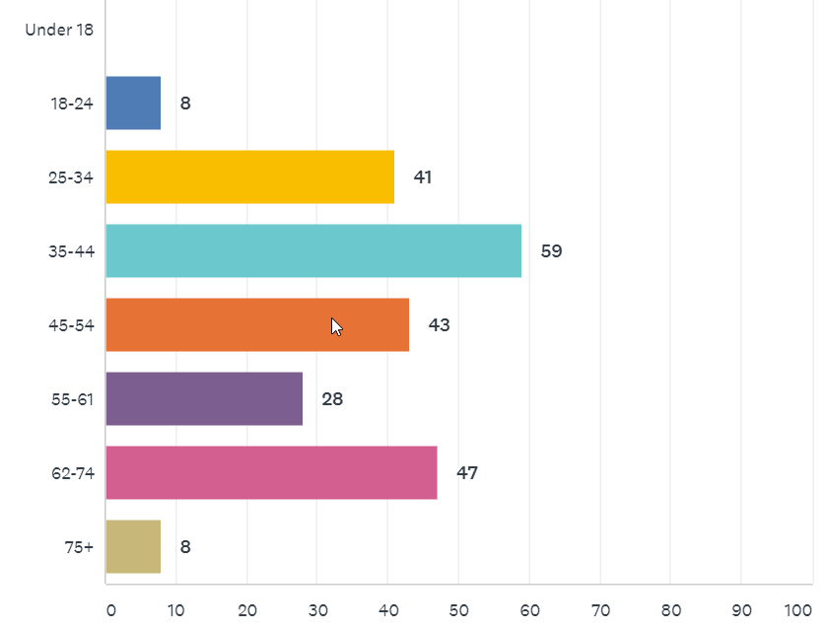
Who took the survey- Age
234 Survey Takers
Notes:
Caroline

Slide 3
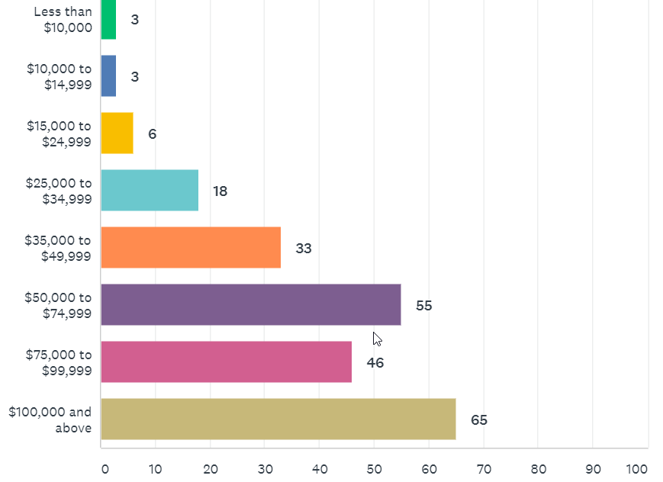
Who took the survey- Income
Notes:
Caroline

Slide 4
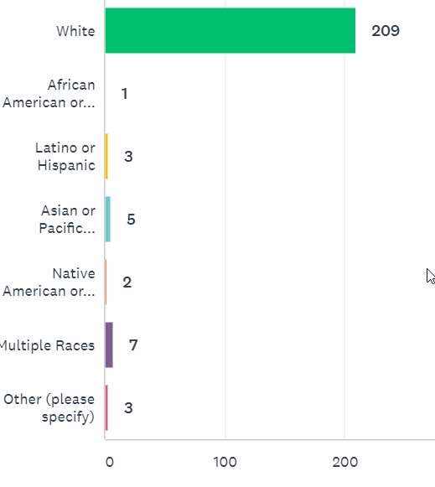
Who took the survey- Race
Notes:
Caroline

Slide 5
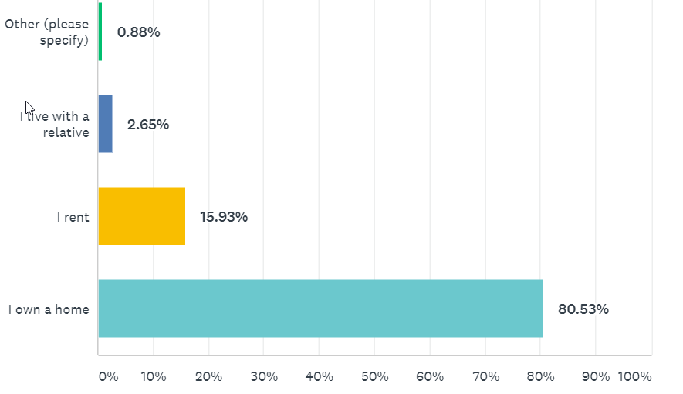
Housing Status
Notes:
Caroline

Slide 6
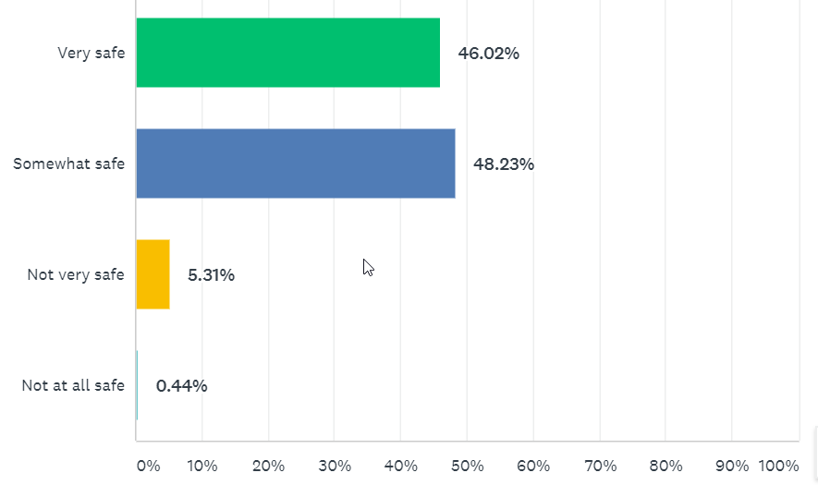
How safe do you feel? (overall)
Compared to City-Wide Survey
42% of overall survey takers feel very safe (safer than city-wide)
49% of overall survey takers feel somewhat safe
7% feel not very safe
1% not at all safe
Notes:
Much safer that Powell Poage Hamilton across the street

Slide 7
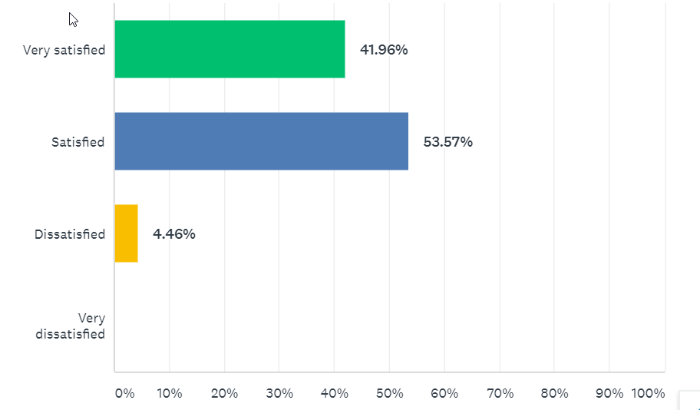
How satisfied do you feel? (overall)
City-Wide
2019 34% feel very satisfied, 51.77% feel satisfied
2014 13% feel very satisfied
Notes:
Caroline or Hetti?

Slide 8
What do you like best about your neighborhood?
Neighbors and people (41)
Park (Weigent Park) (28)
Convenience and location to: Library (South), Jobs (Mayo), Ranisons
Quiet (27)
Schools close by (12)
Walkability and biking (6)
Parks and hiking (12)
Notes:
Caroline or Hetti?

Slide 9
What do you like best about your neighborhood?
“Wonderful neighbors and municipal services. Tree lined streets, good sidewalks, can ride bikes or walk everywhere I need to go, good access to natural public areas.”
“I like the beautiful old homes, the proximity to down town, the well-maintained parks and our super nice neighbors”
“Quiet streets. People are respectful of each other and friendly (but not nosey). Most people keep their properties looking good. We have good services from the city - plows, street cleaning, leaf pick-up, etc.”
“We rent but are long term renters. Our neighborhood is all long term families. Mostly home owners.”
“Neighbors with kids. Easy access to parks and nice sidewalks. Well kept houses, and beautiful bluffs.”
“Proximity to South Branch Library, parks, groceries, Downtown, UWL, and YMCA”
It's very neighborhood-ly. Sorry, I wish I had a better word, but it's not, like, getting trashed by partiers or anything like that every weekend
“Weigent Park, Southside Library, Bean Juice, walkable to Mayo, bikeable to Farmers Market, schools”
“Diversity. Great mix of neighbors - ages, races, economics”
Notes:
Caroline or Hetti?

Slide 10
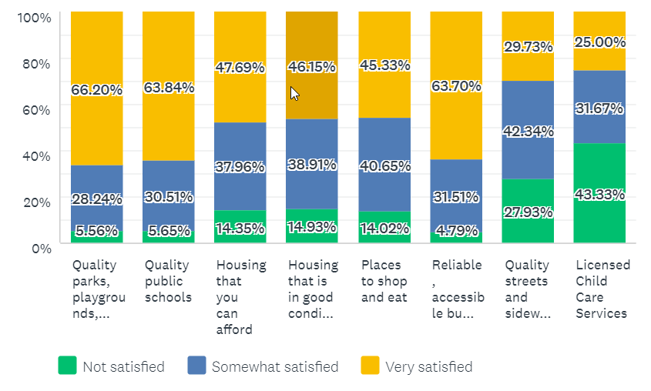
How satisfied are you with your access to the following resources?
People are the happiest with parks, quality schools, bus service.
Least satisfied with access to licensed child care services (if it was important), streets
Housing quality is an issue, especially for low-income.

Slide 11
What would you like to see improved?- Roads, Lighting
Streets (36):
17th St Greenway good idea but bump outs are excessive (111)
Some streets in need of repair, others (less need) are fixed faster
Safer crossways on major streets (Jackson, West, Cass)
Road repairs, pot holes (for bikers and motorists) (1111111)
Alley maintenance
Slow Traffic, Crossings, Biking
Slow traffic on Cass St and Market St (bumpouts etc)
Market and crossing at Jackson St by Jackson Plaza
Dedicated bike lane on Market and Cass
Ferry and 16th needs a roundabout
Improved Lighting (17 times)
Lighting around Weigent Park
West Ave, Mississippi, Winnebago

Slide 12
Housing quality and affordability
Housing (24)
Our neighborhood has done better than others but the decline of surrounding neighborhoods is concerning
Better care of rental housing, rental properties in poor condition (1111111)
Preserve older homes
Focus not only on the “worst housing”, improve the median housing stock
One rental home on our street in poor condition, barking dogs
Address “slum lords”
Limit the number of rentals, concern about the number of rental(1111)
Inadequate off-street parking
Affordable but quality, clean housing (1111111)
Homeless in parks, Salvation Army Population
Housing affordability a concern- can’t find anything on a teacher’s salary
More low-income housing, working poor housing (I make too much to qualify for most but cannot afford what’s out there)
Address racial disparities in homeownership
City should start program to invest in housing stock in our neighborhood

Slide 13
Enforcement Concerns
Parking
Inadequate off-street parking
Code enforcement
Force homes with multiple orders to correct to be maintained
More regulation on rental housing
Landlords held to higher standards
Snow removal , lawn moving
Old furniture in years, unlicensed vehicles
Community Policing (9)
Address vandalism, address crime (1)
Send message city is tough on crime
Address speeding by cars
Develop a strategy to fix area drug problems

Slide 14
Community and Trees
Weigent Park
More improvements, new restroom and new public space
Have children at recreation program pick up garbage
More community gardens or orchards
Place drinking fountain in closer proximity to where people play
Improve play structure at Hogan Administrative building
Trees
Plant more
Boulevard trees that were planted now dead
Bus Service
Bus service for 2nd 3rd shift
More bus transportation
Bus service expanded on weekends
Commercial
Mixed use development at the Kmart spot
Coffee shops but no retail
More affordable grocery stores near by (Festival or Coop too expensive)
Child care a huge need (4)
After school care for school-aged children

Slide 15
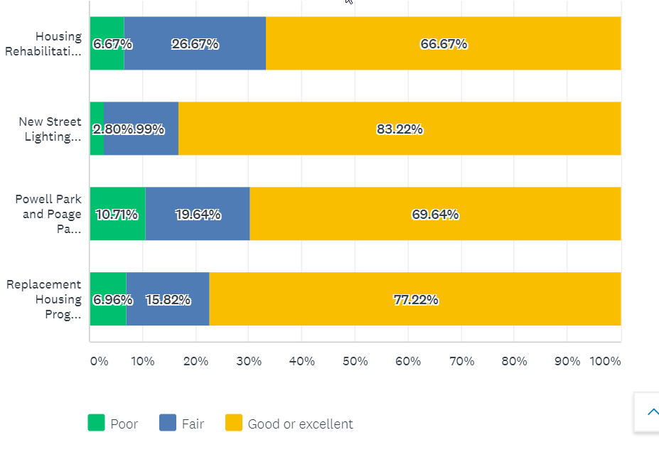
Rate the quality and effectiveness of City programs.
50% of respondents not familiar with the Housing Rehabilitation Loan Program
Notes:
Comments are focus more on housing in PPH and Washburn over parks, some comments negative on Powell and Poage Park, the new homes that are being built are unaffordable, all of them are effective in combination, more street lighting, homes are expensive and falsely advertised, complaint about new occupants of a home, keep up the homes that we are giving them too, advertise the programs better, you can put all the money you want into these neighorhoods but until you tackle drugs and crime it wont do you any good, not enough people use powell park, increase funding to more areas, poage park was built for older kids need equipment for younger kids, more housing incentives for more people, I feel unsafe at powell park, building homes is not the job of government, would like to know more about housing rehabilitation loan program, more work on rehab, money for the northside , negative coments on powell park, wish there was more money for old homes to get fixed up, more dog parks , street lighting is excessive

Slide 16
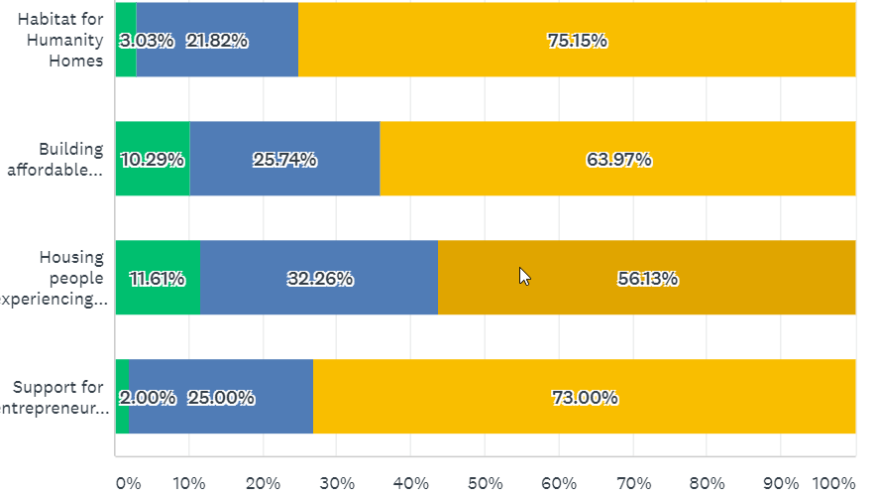
Rate the quality and effectiveness of programs funded by the City.
50% of respondents not familiar with the City’ support to Couleecap and WWBIC to help entrepreneurs

Slide 17
Comments on City projects
Powell Park underutilized, poor design of Powell Park
Applaud efforts to bring investment into challenged neighborhoods by knocking down extremely low-valued homes and making low-interest loans available to other properties
Homes in my area need rehab and a little investment to make a large difference- it is hard to see these once proud homes deteriorate
Do something about the homeless population
Parks department continue to improve its efforts to listen to local constituents
We would love to have a low-interest loan to help updating our home!
Concern that replacing homes, then you are pricing people out of our community
Need new lighting, lighting/cross walk at West Ave between Main and La Crosse
All great improvements having a multiplier effect, I would now consider living in some neighborhoods I wouldn’t have considered before.
Great start to reclaiming lost neighborhoods. Increase the funding for these programs. Money well spent.
Poage park needs more maintenance.
Expand housing replacement program
I love seeing neat, new houses replacing old, condemned ones. This is an important process in cities as historic as La Crosse
Powell Park lacks shade and playground equipment is not toddler friendly at Poage
Better dog parks and more of them
Expand La Crosse Promise to Northside of La Crosse

Slide 18
Comments on funded projects
There is an inadequate supply of affordable housing (1111)
Homeless problem is serious, better supports for homeless
Support for mental health and addiction issues
I am concerned when the homeless are housed, the housing is very poor quality with bedbugs and roaches
Couleecap is excellent, Catholic Charities is understaffed and the leadership has been unresponsive to requests of volunteers like me.
Wonderful to see the City government partner with non-profits
La Crosse recognizes the needs and responds appropriately
Bring back Myrick Park
I hope that programs to support the homeless are successful. We’ve experienced a meth house in our neighborhood. The tenant as supported by a program. Can there be another component to the program?
Mediation for neighbors – territorial disputes

Slide 19
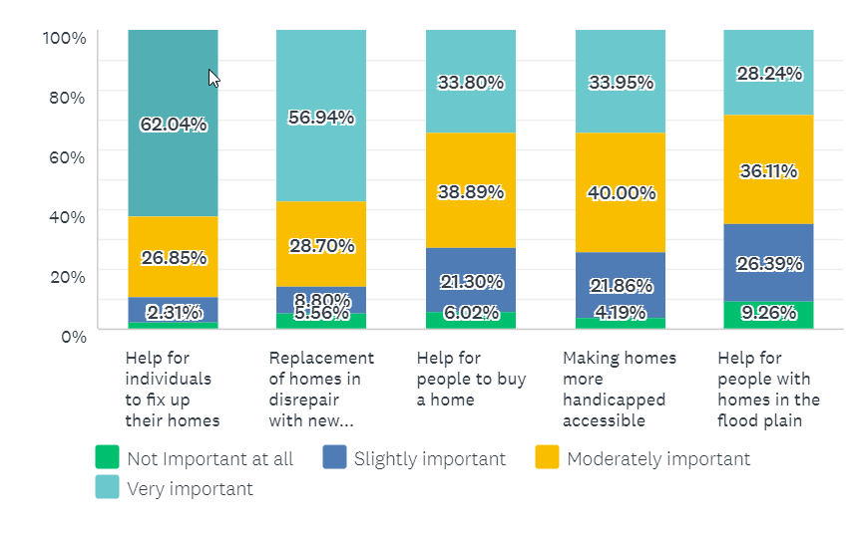
Programs that meet City’s homeownership needs
Programs to address poor housing quality more important for this neighborhood than others
Notes:
Th

Slide 20
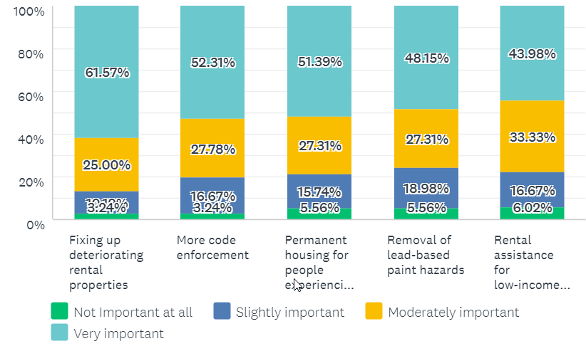
Programs that meet City’s rental needs

Slide 21
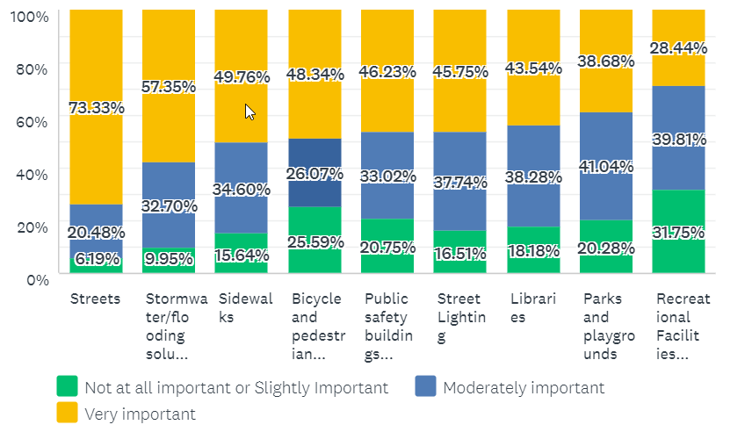
How important are the following capital improvements?
49%
47%
42%
42%
41%
32%
79%
55%
55%
Bicycle and pedestrian improvements rank higher, recreational facilities ranked low
Notes:
Everything is generally more important than it was 5 years ago.

Slide 22
Overall (% very important)
Streets (73%)
Help for individuals to fix up their homes (62%)
Fixing up deteriorating rental properties (62%)
Stormwater/Flooding solutions (57%)
Replacement of in disrepair with new homes (57%)
More code enforcement (52%)
Permanent housing for people experiencing homelessness (51%)
Sidewalks (49%)
Bicycle-pedestrian improvements (48%), lead hazards (48%)

Slide 23
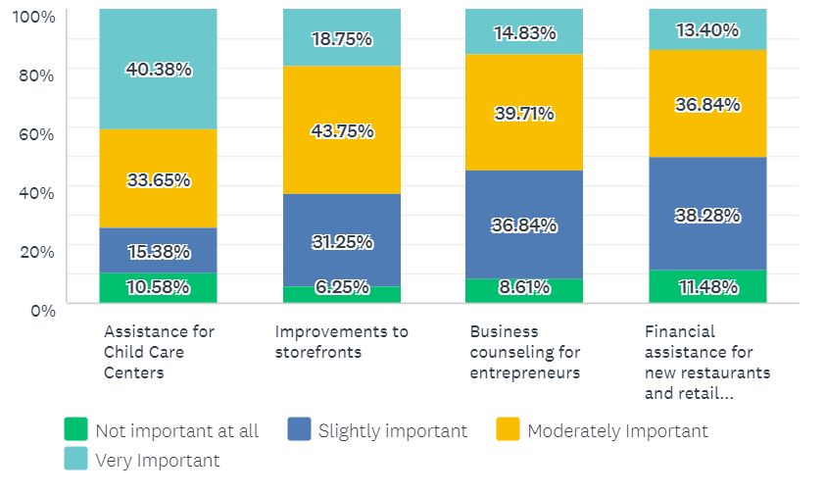
How important are these Economic Development programs?
Notes:
Child care emerges as important and elsewhere in the City , 48% of low income individuals stated this was very important

Slide 24
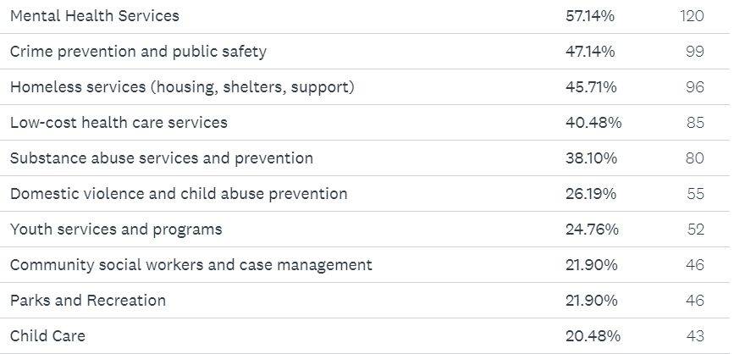
Four (4) types of services that City should prioritize
Notes:
Child care emerges as important and elsewhere in the City

Slide 25
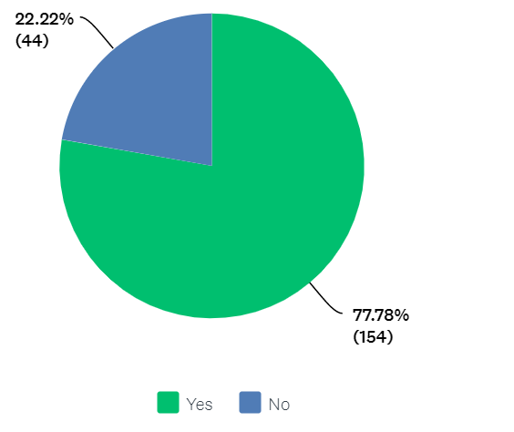
Would you support a strategy that targets resources to specific neighborhoods ?
Notes:
Child care emerges as important and elsewhere in the City

Slide 26
Any final Comments?
Hang in there, you are doing a great jobs
Demolish more homes and rebuild
Big wealth inequalities, funds should be directed towards people who need them (outside this neighborhood)
Focus on the homeless population
I am thankful for a city planning office that is forward-thinking and socially-conscience.
Not enough child care available and the cost is comparable to a mortgage
Assess all users, including tax exempt insittutions, for the services they use
Bring back a zoo with animals
Update Myrick Park
Need a performing arts concert hall
Moving our city in a goo ddirection
La Crosse is on a great path to being the envy of other cities of our size and facing similar challenges. Ignore the hate from people who long for a La Crosse that never was. Our history is depending on industries such as lumber. Brewing. Factories. They have come and gone. And we are still here. Reinventing ourselves yet again. Let’s put more attention on that.
Huge thank you to all of our police force who are working hard day in and day our to make our city safe. More support to them is always needed.
The city needs to invest in helping people experiencing homelessness, mental illness, and addiction.
Rising housing costs are an issue, and the high property tax rates. If anything can be done there, would be good. UWL salaries and public educator salaries have stagnated over the past 8 years, but attracting and keeping people in those jobs requires good housing and childcare and public schooling options.

Slide 27
Any final Comments?
- I love La Crosse. But it's becoming harder to be a homeowner because of outrageous taxes. Get these vacant properties on the tax roll! And help fund police to fight the drug epidemic that is a blight on our city.
- There is one community development need: state of most roads. Everything is secondary.
- Emphasize programs that make it easier/safer for residents without cars.
- More road biking trails
- Help with the homeless problems in the parks.
- I am very proud to be a resident in the City of La Crosse.
- make it unattractive to commit crimes in La Crosse---high unpleasant consequences--zero tolerance. Take care of what we already have before creating new stuff that needs maintenance. We don't need fancy--we need well maintained....and safe.
- Disappointed with paid parking. La Crosse isn’t a large city. One of the perks of spending money out in La crosse is cheap or free parking. Otherwise it’s not far to the twin cities.
- My neighborhood continues to have issues with landlords who do not provide off street parking to their renters. At times there can be six cars from one house on the street. The problem exacerbates during the winter with snow removal.
- The mayor is doing a good job requesting/demanding that we have regional partners, and that they share the cost of all of the services that the city provides. I am sick of hearing my friends brag that they pay lower taxes in the suburbs, but then talk about what the city should and should not be doing. It is good to have active neighborhoods, but they are not elected officials who should be making significant decisions.
- I drive my son to school on the Northside of La Crosse every day and am very concerned about the lack of safe cross walks for children and youth along Hwy 35 as it passes between Logan High and Logan Middle and Northside Elementary school. There are many young people waiting to cross in the morning and afternoon and very few cars stop for them
-Stormwater management is a growing problem
-Water taxis on the river and a streetcar line running between north and southside

Slide 28
Any final Comments?
Let’s help the core of the community, freeze property taxes for people over 65, with income under 50,000 Give money to the police department to do walking tours of there area, feet on the ground better then quick drive by And create an office for people to call if they think they are being scammed
Rental Improvements, deteriorating home improvements (including rentals) and continued safety and neighborhood revitalization should be a priority. We have a beautiful city with so much potential but we have to do something to get it cleaned up!!!
Better/more boat launches on the south side.
Keep investing in preventative measures like community policing, community social workers and services, child care, and assistance with navigating the system. One thing I hear about is the lack of connection between benefit system, where there are sharp cutoffs between benefit categories, such as a family losing their housing support because of a small raise in pay. Anything that can be done to help prevent those disconnects for families is important.
I would like to see the City of La Crosse take an equity approach to the allocation of the CDBG funds. That is to say, prioritize the needs of people of color, those who experience food insecurity and/or homelessness, folks who identify as LGBTQ, etc.
Thank you for the opportunity to give my opinions.
Affordable housing either for rent or purchase needs to happen.
TAXPAYER DOLLARS SHOULDN'T BE GOING TO PEOPLE WHO ARE UNWILLING TO WORK EVEN THOUGH THEY COULD. DON'T SUBSIDIZE LAZINESS.
Address the basic infrastructure needs, specifically streets and flooding. Help people better themselves, don't give them a handout, give them a hand up.

Slide 29
Next steps for me
Finalize priority areas for Community Development Needs
Continue to strategize on how to bring products to incentivize repairing of existing housing
Homelessness
Affordable, quality housing for a variety of income levels
Prioritize lighting projects

Slide 30
For Consideration by Weigent Neighborhood
Education on City-app to report code enforcement concerns
Capital Improvement Advocacy
Streets: which ones? identify potholes
Lighting : where? (Park, West Ave, Cass)
Slowing down traffic on Cass and Market
Crossing by Jackson Plaza

Slide 31
Reactions? Questions?
Caroline (Neilsen) Gregerson
Community Development Administrator
608.789.7393 (office)

