Slide 1
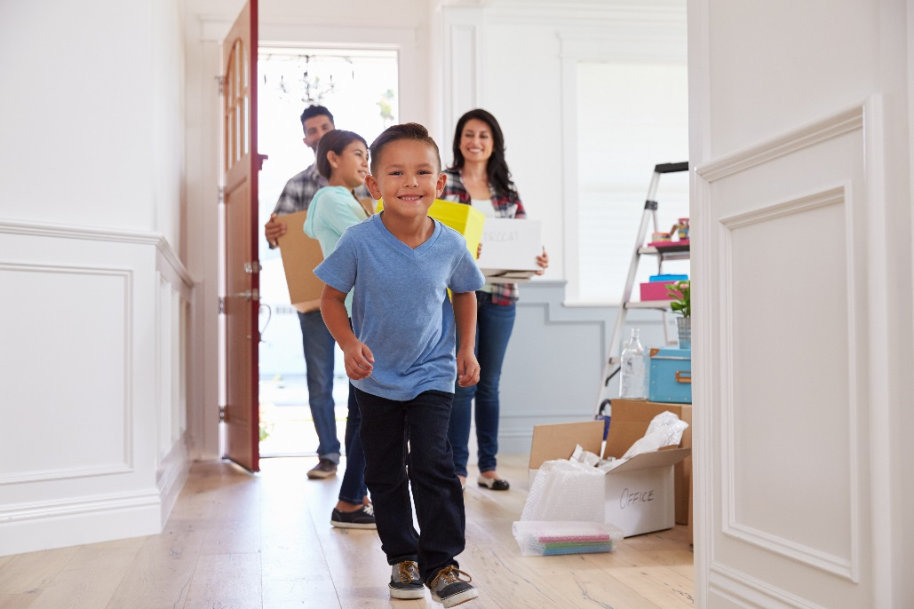
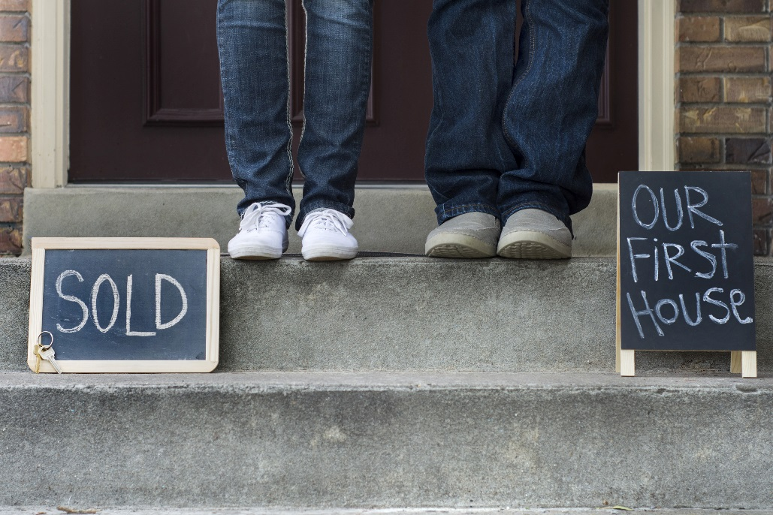
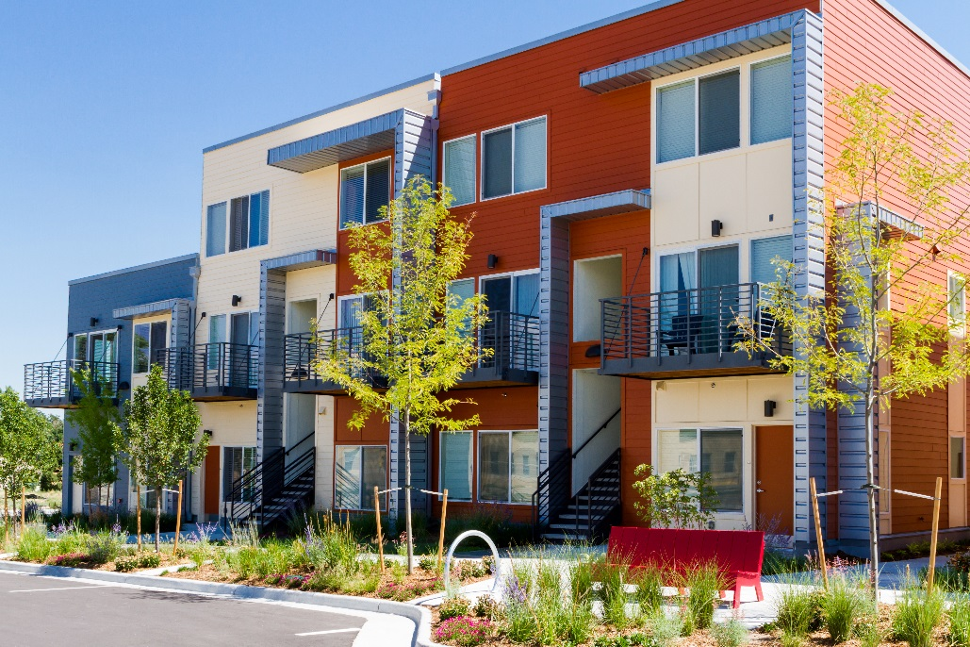
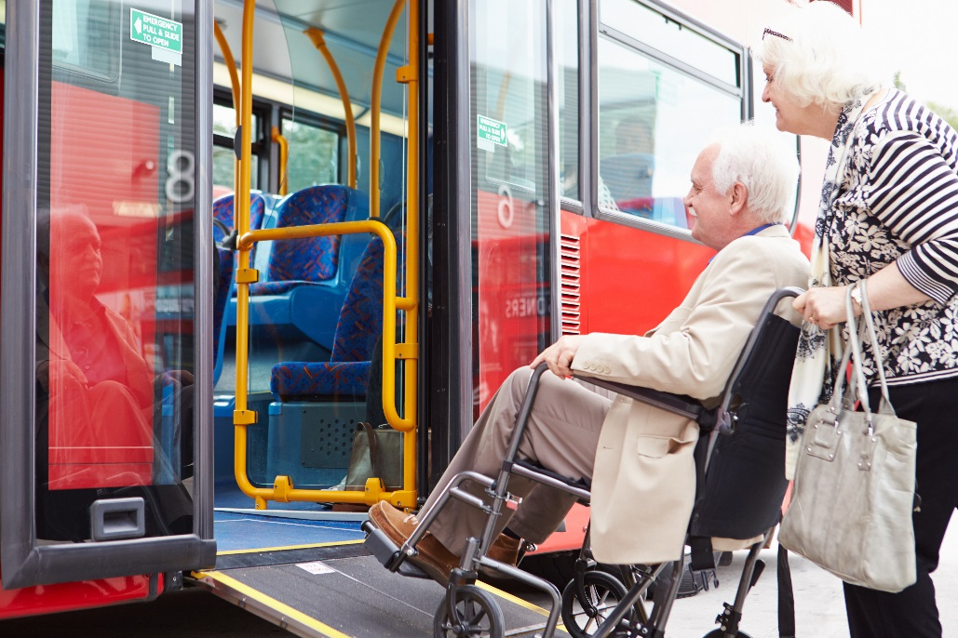
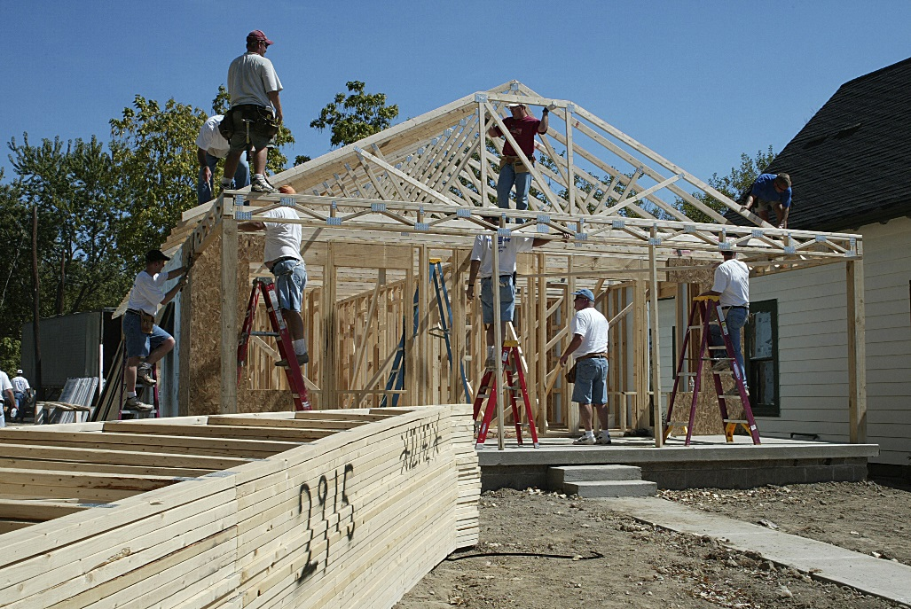
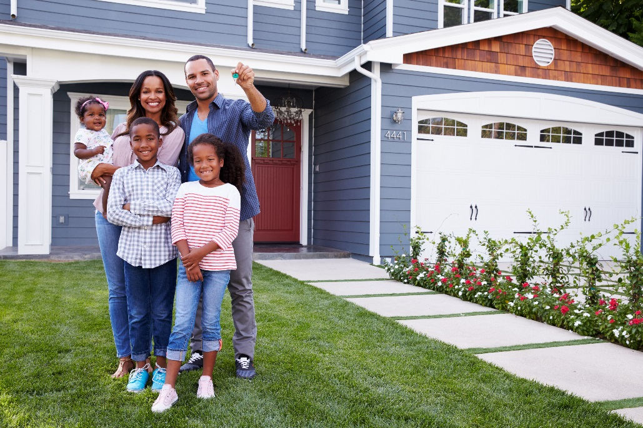
Community Needs Survey
To inform the Community Development Block Grant and HOME
5-year plan – look at how to prioritize our funds

Slide 2
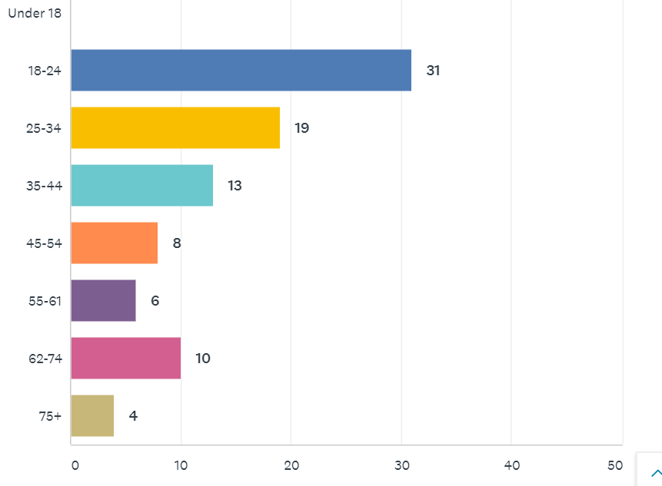
Who took the survey- Age
60 Survey Takers (Downtown), 31 Goostown = 91
Notes:
A younger populations than other neighborhoods

Slide 3
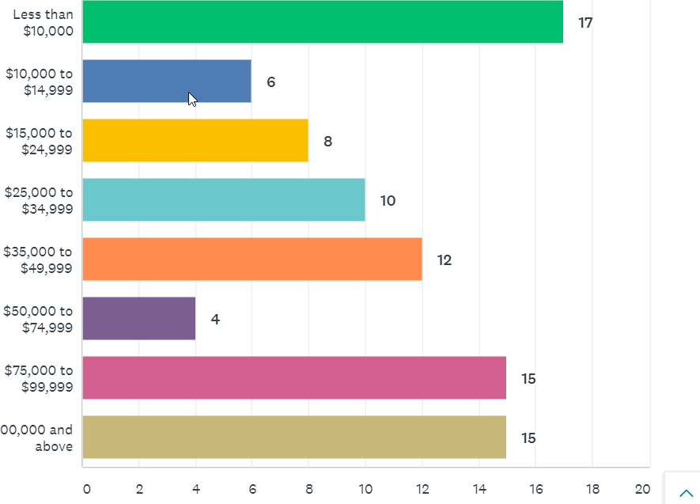
Who took the survey- Income
Notes:
Caroline

Slide 4
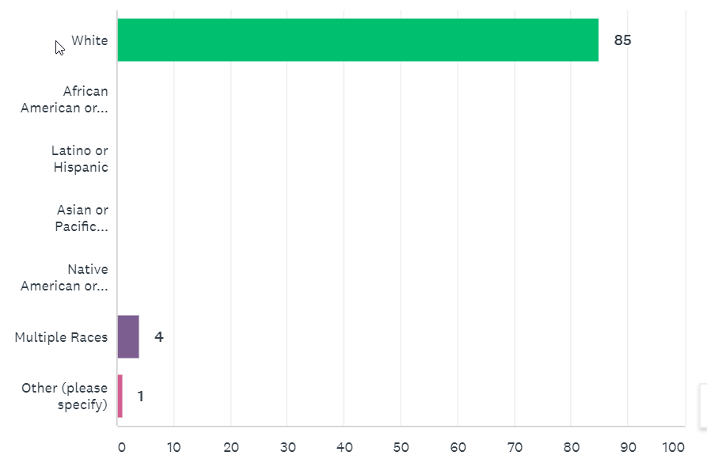
Who took the survey- Race
Notes:
Caroline

Slide 5
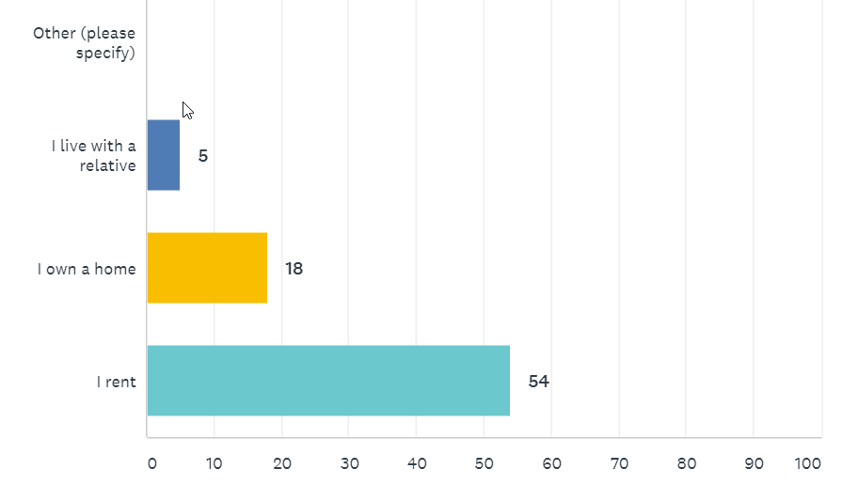
Housing Status
Notes:
Caroline

Slide 6
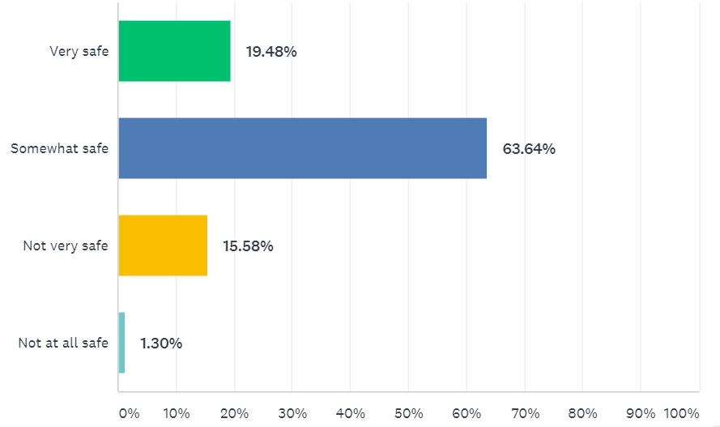
How safe do you feel? (overall)
13 people feel not very safe or not at all safe
(9 renters, 4 homeowners, 12 white, 5 earning more than $75K per year)
Compared to City-Wide Survey
42% of overall survey takers feel very safe (safer than city-wide)
49% of overall survey takers feel somewhat safe
7% feel not very safe
1% not at all safe
Notes:
Much safer that Powell Poage Hamilton across the street

Slide 7
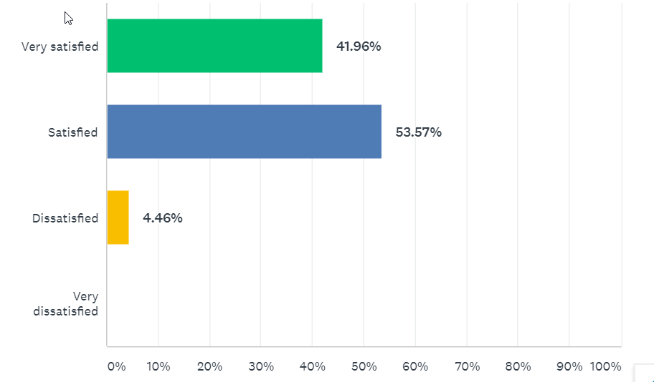
How satisfied do you feel? (overall)
13
39
24
1
City-Wide
2019 34% feel very satisfied, 51.77% feel satisfied
2014 13% feel very satisfied
Notes:
Caroline or Hetti?

Slide 8
What do you like best about your neighborhood?
Convenience, walkability, closeness
Library, shopping, YMCA, UWL
Walking distance to downtown, marsh, garden, riverside park, coffee shops, grocery
Close to Campus
Respectful and kind
Historic, character of the homes
The Trees
Clean
Nice neighbors
Family friendliness (YMCA, Children’s Museum, etc)
Notes:
Caroline or Hetti?

Slide 9
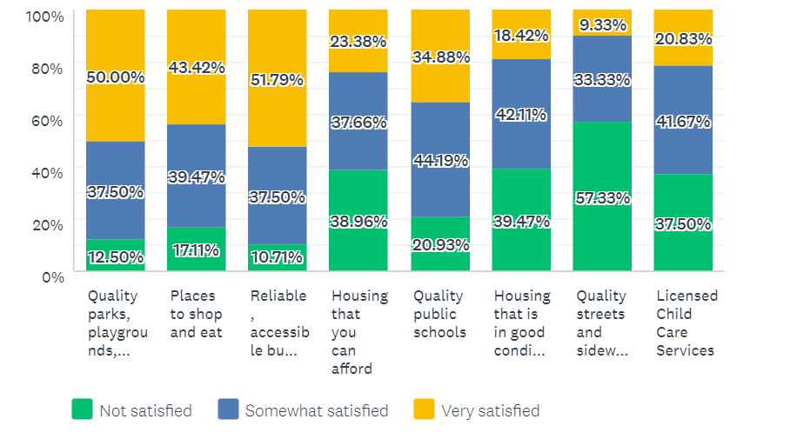
How satisfied are you with your access to the following resources?
Housing quality, housing affordability much more of a concern than City-Wide
Less satisfaction with quality public schools than City-wide
More satisfied with places to shop and eat
Less people that care about child care and quality public schools

Slide 10
What would you like to see improved?- Roads, Lighting
Streets or Street Lighting (15)
Around campus, especially La Crosse St
For safety and walkability
Dead boulevard trees, more beautification
Crosswalks (West Ave and State St)
Parking
Residential parking permits
Cameron Park (2)
Crime/Safety, Enforcement (4) i.e. campers using boulevards as yards
Noise enforcement, particularly at bar time, Crossfire loitering
Housing (6)- affordable, safe, quality housing, better maintenance of rental properties, high density of real estate development,

Slide 11
Other
Better enforcement of snow and ice removal from sidewalks and crosswalks
Too much student housing and not enough parking for them
Police engaging more positively, less sirens
Blight
Better maintenance of the bike trails
More accessible bus transportiation
As someon who doesn’t drive, walking in winter is a nightmare. A faster bus schedule would be great too. The apartments downtown are too expensive.
Focus on making a place to attract mid/upper income, not lower income.
Use tax dollars to remove snow from sidewalks (model from upstate New York)

Slide 12
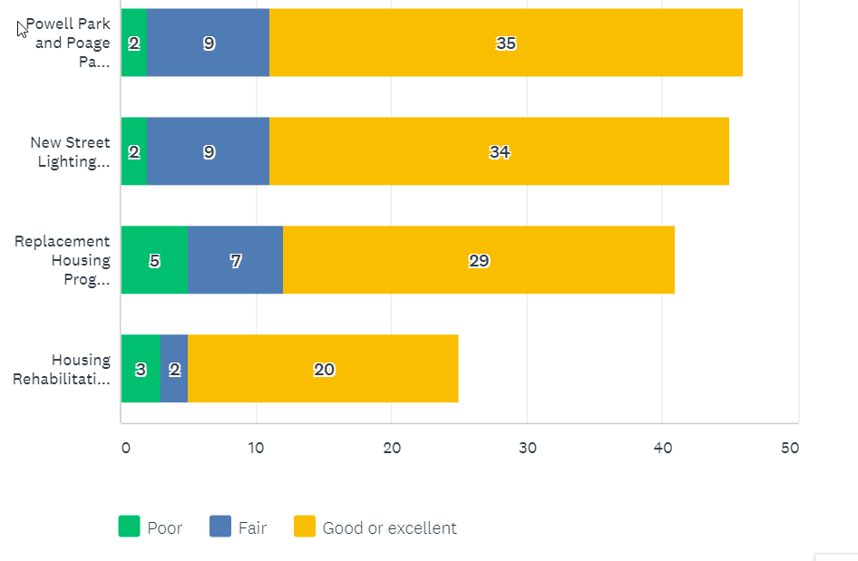
Rate the quality and effectiveness of City programs.
63% of respondents not familiar with the Housing Rehabilitation Loan Program, 40% RHP
Notes:
Comments are focus more on housing in PPH and Washburn over parks, some comments negative on Powell and Poage Park, the new homes that are being built are unaffordable, all of them are effective in combination, more street lighting, homes are expensive and falsely advertised, complaint about new occupants of a home, keep up the homes that we are giving them too, advertise the programs better, you can put all the money you want into these neighorhoods but until you tackle drugs and crime it wont do you any good, not enough people use powell park, increase funding to more areas, poage park was built for older kids need equipment for younger kids, more housing incentives for more people, I feel unsafe at powell park, building homes is not the job of government, would like to know more about housing rehabilitation loan program, more work on rehab, money for the northside , negative coments on powell park, wish there was more money for old homes to get fixed up, more dog parks , street lighting is excessive

Slide 13
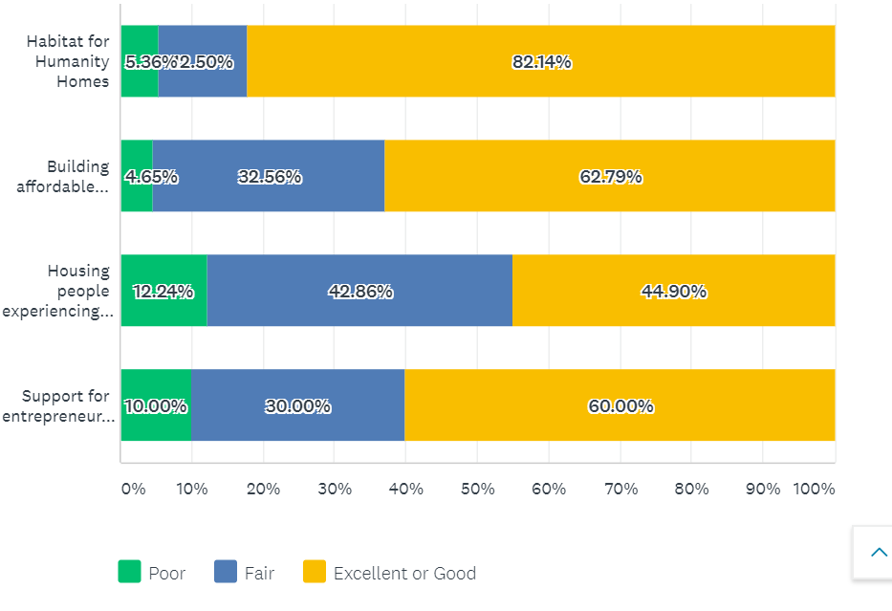
Rate the quality and effectiveness of programs funded by the City.
55% of respondents not familiar with the City’ support to Couleecap and WWBIC to help entrepreneurs

Slide 14
Comments on City projects (17)
City Programs
We have a large home that needs work but wouldn’t qualify for a loan. Would welcome assistance to do so.
Lighting is too bright
Powell Park is not utilized
Find a better way to get into a “problem property”
More housing incentives for more people
Warmer lighting colors
Liked the lighting!
Consider density! Adding townhomes
I wish I knew about these programs
City is spending too much money on these nice new homes for low-income
$1000 per month is not affordable
Would like to see old homes restored

Slide 15
Comments on funded projects
Solutions to end homelessness aren’t working
Why does the Salvation Army have to be in the Downtown? Also, should not be in the party atmosphere of 2 colleges
I am concerned about the homeless problem in the parks
Everything is a college dump or luxury. Very hard to find quality housing
Enabling homelessness is failing
More effots to find shelter and services for homeless
Difficult to find an affordable one-bedroom apartment. The ones for rent are dirty and not well taken care of.
Like to know more about WWBIC
Minimal housing that accepts Section 8 Vouchers. Very few homes for $1000 or less per month.
The apartments the City is building are not affordable.

Slide 16
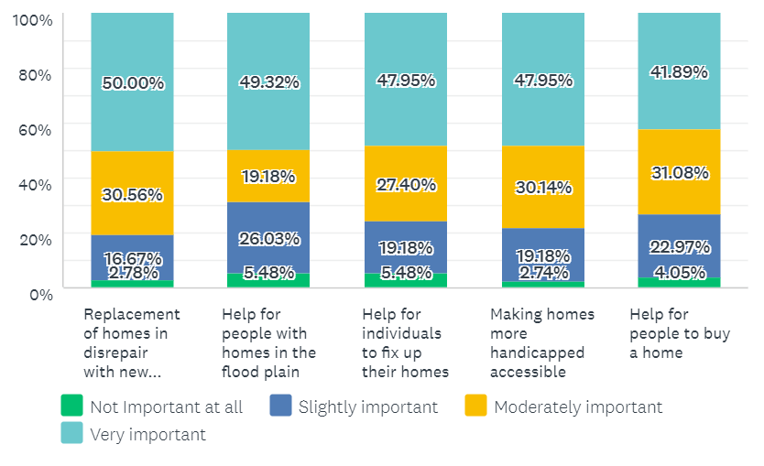
Programs that meet City’s homeownership needs
Less support for these programs than City-wide, although still strong support for Replacement
Notes:
Th

Slide 17
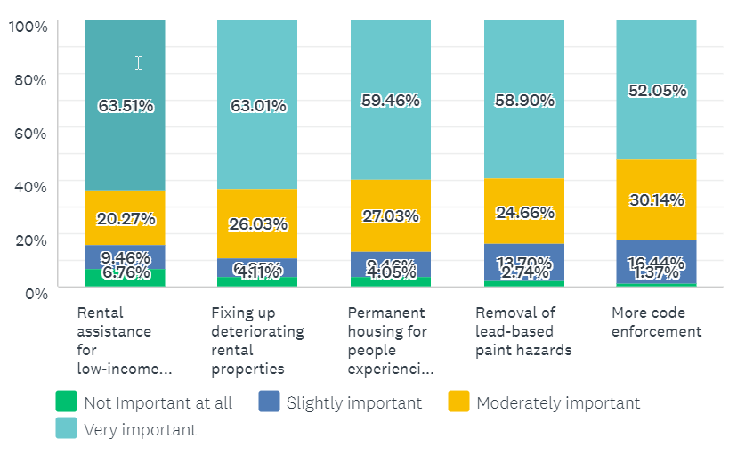
Programs that meet City’s rental needs
Much stronger support for programs to assist renters

Slide 18
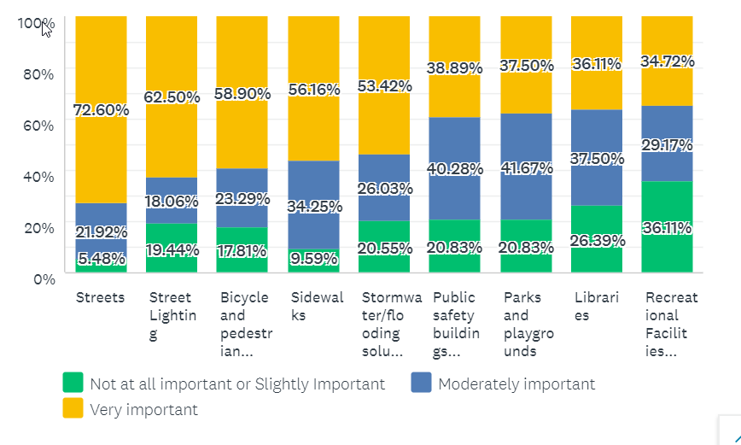
How important are the following capital improvements?
49%
47%
42%
42%
41%
32%
79%
55%
55%
Streetlighting, bicycle pedestrian safety improvements, sidewalks rants much higher
Notes:
Everything is generally more important than it was 5 years ago.

Slide 19
Overall (% very important)
Streets (72.6%)
Rental assistance for low income people (63%)
Fixing up deteriorating rental properties (63%)
Street Lighting (62.5%)
Permanent housing for people experiencing homelessness (59%)
Removal of lead-based paint hazards (58%)
Sidewalks (56%)

Slide 20
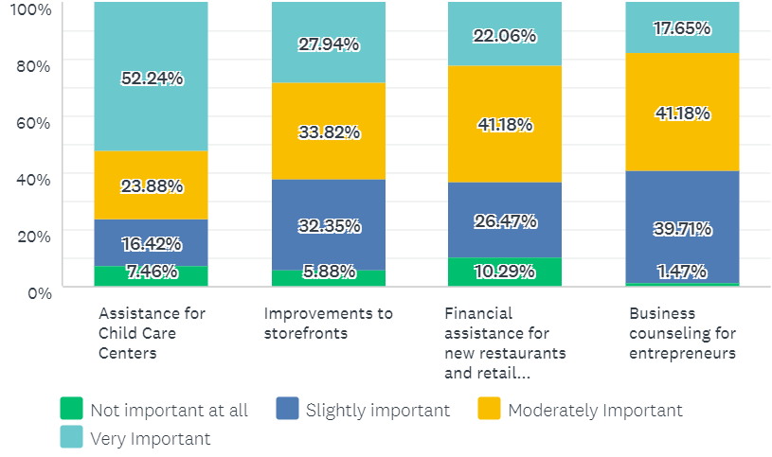
How important are these Economic Development programs?
Child care (if important to you), is very important
Notes:
Child care emerges as important and elsewhere in the City , 48% of low income individuals stated this was very important

Slide 21
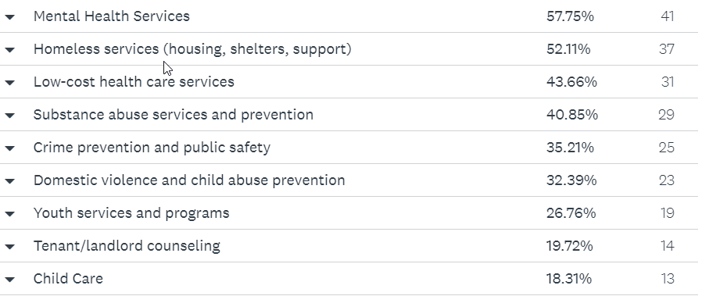
Four (4) types of services that City should prioritize
Crime prevention ranks lower than City-wide
Notes:
Child care emerges as important and elsewhere in the City

Slide 22
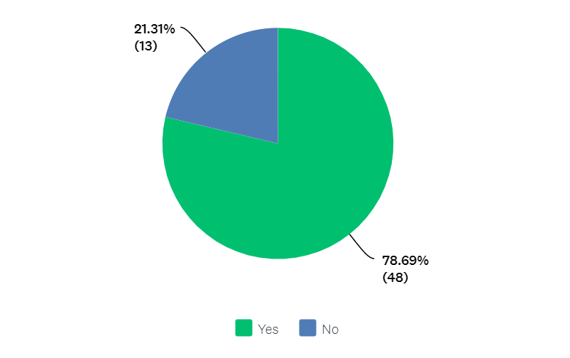
Would you support a strategy that targets resources to specific neighborhoods ?
Notes:
Child care emerges as important and elsewhere in the City

Slide 23
Any final Comments?
Senior Citizens
While funds are needed to address drugs/addiction, homelessness, it will also require business and community response team who allow these individuals to find work, while they are looking to change their behaviors. Landlords are making a lot of money taking advantage of programs that cover housing expenses and offering sub-standard housing. Having so many unkept properties puts homeowners at a disadvantage. Quick fixes will not work.
Development of minority available seats for Council
Programs should be priorities on basic, early support, education, and community engagement, as well as evidence-based decision making rather than tunneled surveys such as this one
I moved back her after living in St Louis. It’s sad to see the amount of homelessness that is experienced in such a resource-rich community. We need more mental health and drug rehab facilities.
Homelessness is complex. The location of the Salvation Army present challenges that are hard to solve. I am not sure how this can be improved.
Affordable housing and case management for those experiencing homelessness
Living downtown for 18 years, I have seen homeless with and without mental illness. Help them.

Slide 24
Taverns should be closed at midnight.
Street department needs assistance. They do a poor job of repairing roads and often do more harm than good when they overfill potholes. Leaf collection is inconsistent. City alleys are hit and miss, some are paved others are gravel, more look horrible with garbage and rarely used vehicles that park in them.
The Homeless Challenge: shelter, mental health, addiction treatment, day services, law enforcement, vocational services. Find funding to collaborate with existing agencies.
Maintain affordable housing opportunities, particularly in the downtown and central neighborhoods. I want to see the Downtown improved, I don’t want to price out the working class.
The City of La Crosse is a great place to live, with a lot going on. But the areas for improvement- are child abuse and neglect, help for the homeless, pedestrian safety.
More low-income housing is needed. More homeless services, especially shelters for the homeless from November to April. Expand the warming center. Remove snow and ice from sidewalks and all bus stops.
Community watch groups
I am responsible for repair and snow removal. But then the city dictates how it is done. (Either the city should take complete responsibility for it or relinquish it to the citizenry). Less funds for private industry (like meeting housing needs). Focus on public works, parks, sidewalks. Tax breaks or loans for child care, entrepreneurs, and restorative projects.

Slide 25
Any final Comments?
Taking the climate crisis seriously and mitigate flooding. Do more to encourage public transit and bike/pedestrian safety. Have protected bike lanes. Repair existing affordable housing. Rehab existing residents in La Crosse (versus adding to the sprawl). Don’t have free parking in downtown ramps.
Invest community grants into child care and new day care centers.
I support public safety, transportation, but also mental health, homelessness, substance abuse.
More parking downtown.
Increase to bicycle, pedestrian, public transportation infrastructure. Support for renters and more availability in low-income renting and housing.
A free permit to park downtown if you live downtown.
Invest in child care to make the community stronger.
Roads need to be redone. If you are going to be bike friendly, please educate car drivers on how to share the road.
Major need for affordable housing and mental health services.
Focus on Bridgeview Plaza Area. Make it nice and a gateway to our city, instead of one of the biggest eyesores.

Slide 26
Other Data
The cost of rent and purchasing continues to rise. Not enough supply to meet the demand. Particularly for those living in poverty.
Homelessness numbers in La Crosse are still overall high (but decreasing compared to years prior). Chronic homelessness is very high.
Unemployment is low but still need businesses that serve neighborhoods.
Suburban sprawl continues.

Slide 27
Consolidate Plan Priorities
Marketing of the Housing Rehabilitation Program
Launching the Lead Safe Grant Program
Strategizing on ways to improve the quality of rental properties
Undertake a regional affordable housing market assessment
Launch an affordable housing fund for the City
Continue to work collaboratively to address homelessness and create new units set-aside for homeless individuals
Continue the Replacement Housing Program
Child Care
Prioritize mental health

Slide 28
Neighborhood Association
What did you learn today that you think could be a focus for the neighborhood?
What did you think of the survey?
Caroline (Neilsen) Gregerson
Community Development Administrator
608.789.7393 (office)

Slide 29
Reactions? Questions?

