Slide 1
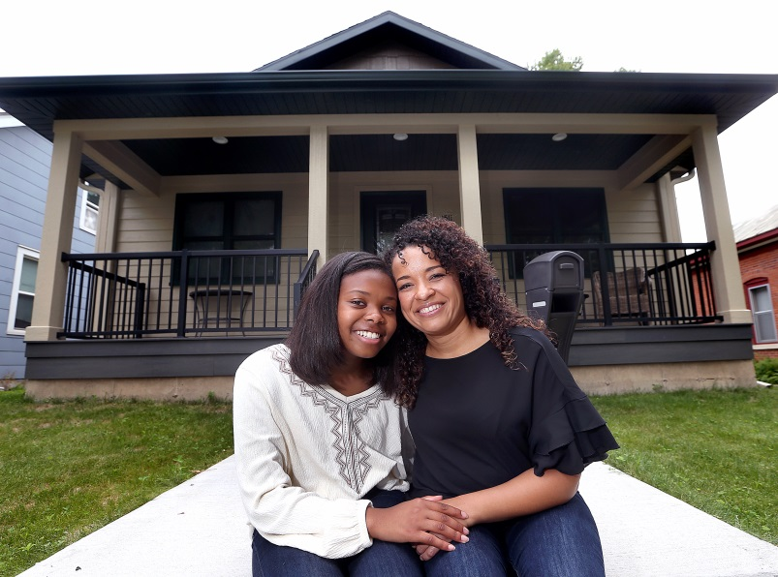
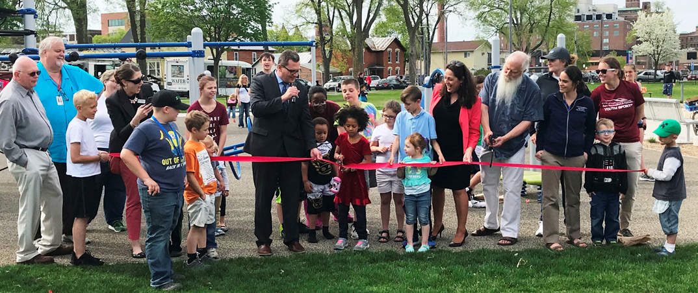
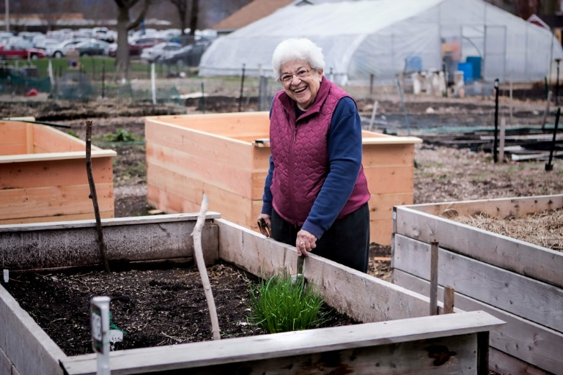
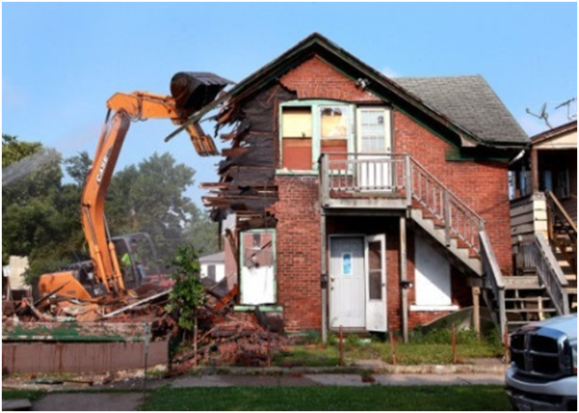
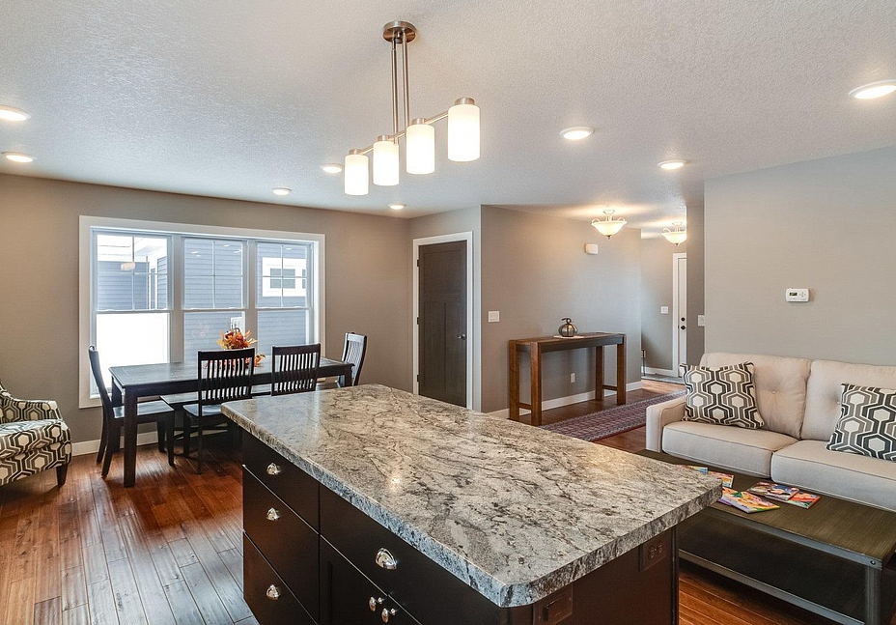
Community Needs Survey
To inform the Community Development Block Grant and HOME
5-year plan – look at how to prioritize our funds

Slide 2
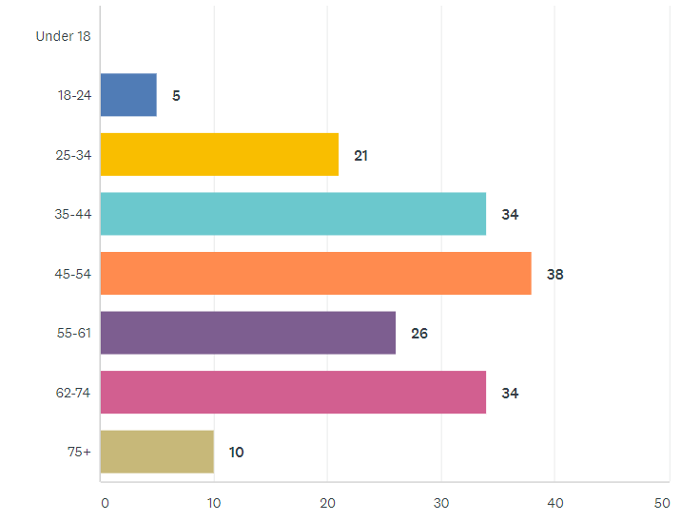
Who took the survey- Age
167 Survey Takers
Notes:
Caroline

Slide 3
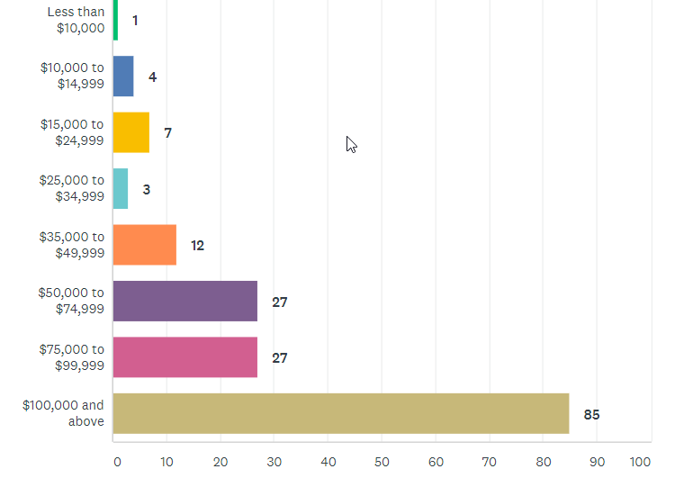
Who took the survey- Income
Higher income neighborhood
50% over $100,000
Notes:
Caroline

Slide 4
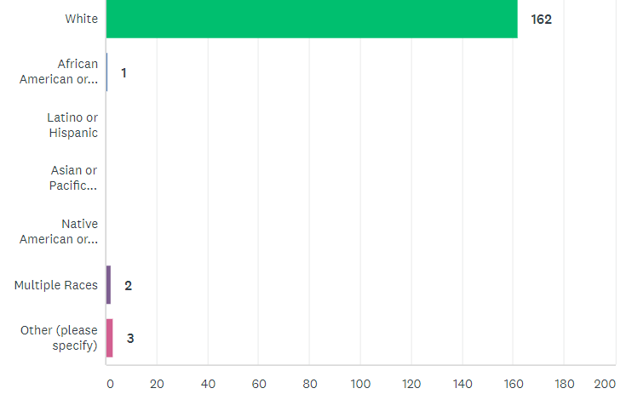
Who took the survey- Race
98% White
Notes:
Caroline

Slide 5
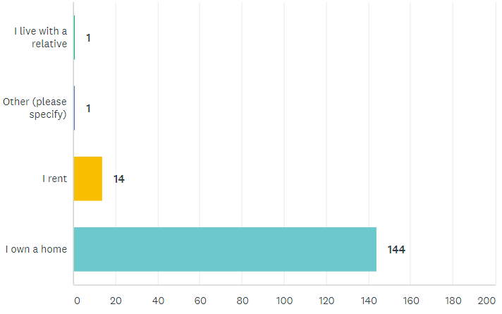
Housing Status
Mainly homeowners (90%)
Notes:
Caroline

Slide 6
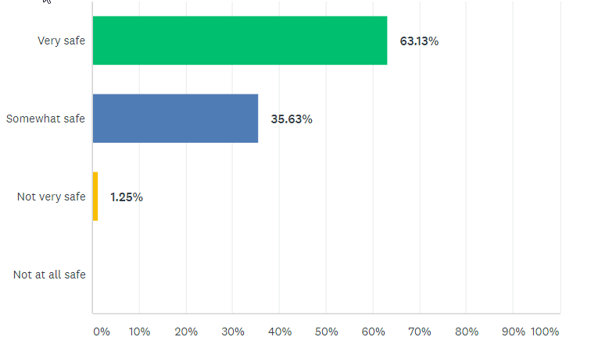
How safe do you feel? (overall)
People feel much safer than in other City neighborhoods
Compared to City-Wide Survey
42% of overall survey takers feel very safe 49% of overall survey takers feel somewhat safe
7% feel not very safe
1% not at all safe
Notes:
Much safer that Powell Poage Hamilton across the street

Slide 7
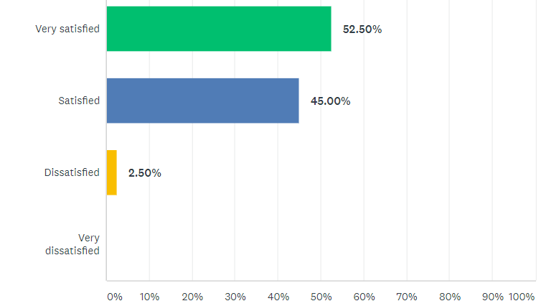
How satisfied do you feel? (overall)
City-Wide
2019 34% feel very satisfied, 51.77% feel satisfied
2014 13% feel very satisfied
Notes:
Caroline or Hetti?

Slide 8
What do you like best about your neighborhood?
Neighbors, single family homes (46)
“kept up homes”
“beautiful blocks with variety of homes and character”
“Great neighbors that I know and trust”
“Friendly welcoming neighbors”
“Active neighbors, good community”
“knowing neighbors are there to help”
“family friendly, neighborly character”
“the beauty, older homes, abundant trees”
“families with children”
Notes:
Caroline or Hetti?

Slide 9
What do you like best about your neighborhood?
Convenience and proximity to: Downtown, the college, Emerson school
Amenities (parks, trail access, school, run and bike with my family)
Schools close by (13)
Quiet (19)
Walkability and biking (7)
Parks and hiking (15)
Notes:
Caroline or Hetti?

Slide 10
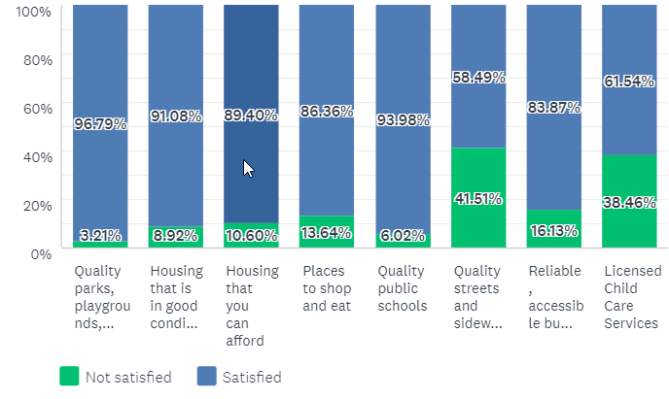
How satisfied are you with your access to the following resources?
People are the happiest with parks, quality schools, housing in good condition
Least satisfied with access to licensed child care services (if it was important), streets
Housing affordability is not a concern

Slide 11
What would you like to see improved?- Roads, Lighting
69 had no comment here (40%) “This is an excellent neighborhood”
Streets and Parking Concerns (44):
No on street parking near campus (1)
New parking rules meant more student parking in my area
Poor Condition of La Crosse St (111111111111111)
Slow Traffic, Crossings, Biking, Public Transit
Speeding on Main Street, speeding by Blessed Sacrament (24th)
Flashing crosswalk on La Crosse St and Hillview/Myrick Park Dr
Intersection of Campbell and 23rd, Campbell and 22nd
Crossing at Main and West Ave
Weeds in the street cracks
Bike lanes, green paint to signify (111), More bike/ped infrastructure
No street widening projects (Losey, La Crosse)
Make public transportation the easiest choice.
Thank you for roundabouts and traffic circles
Improved Lighting (1111)
North of La Crosse St
Less lighting (one comment)
Noise ordinance enforcement

Slide 12
Housing quality and affordability
Housing (20)
Neglected college rentals (1)
Single family homes being converted into rentals.
Rental property “invasion”, multiple unrelated indivdiuals
Revitalization of rental housing and demolition/replacement of housing closer to downtown – newer rowhouses, townhouses. Currently the only options are expensive high density or run down housing
Bad landlords who neglect homes and take advantage of the poor and of college students
I live near UWL. In the last year, 6 properties have changed to student rentals, even though they are zoned single family. More than 2 unrelated.
Property maintenance
Code enforcement
Fewer UWL Party houses
More condo options
Lower taxes (1)
Upkeep of rental homes
Prevent homes from turned into rentals

Slide 13
Enforcement Concerns
Snow Removal
Clear snow with accessibility in mind for people using wheelchairs, strollers, and bikes
Trees and Parks
A nice dog park (Myrick too small)
Plant more, more trees (11)’
Re-wild green space with native plants , plants in roundabouts
Public food forests
More small green spaces for neighbors to meet
Neighborhood Retail
Grocery Desert
Small general store so you don’t have to drive to get a stick of butter,
Nothing in walking/biking distance to purchase a stapler or curtains
More dining options East of West Ave
Child care a huge need (4)
After school care for school-aged children
YMCA after school care long waiting list

Slide 14
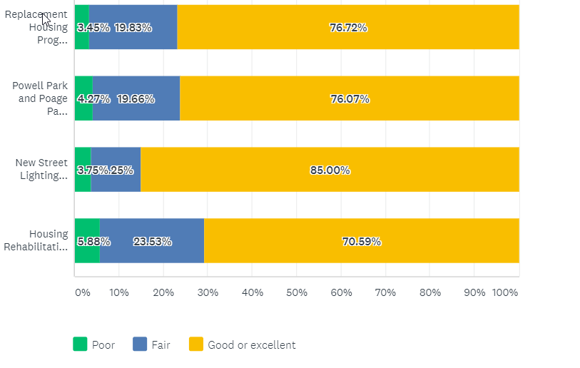
Rate the quality and effectiveness of City programs.
Notes:
Comments are focus more on housing in PPH and Washburn over parks, some comments negative on Powell and Poage Park, the new homes that are being built are unaffordable, all of them are effective in combination, more street lighting, homes are expensive and falsely advertised, complaint about new occupants of a home, keep up the homes that we are giving them too, advertise the programs better, you can put all the money you want into these neighorhoods but until you tackle drugs and crime it wont do you any good, not enough people use powell park, increase funding to more areas, poage park was built for older kids need equipment for younger kids, more housing incentives for more people, I feel unsafe at powell park, building homes is not the job of government, would like to know more about housing rehabilitation loan program, more work on rehab, money for the northside , negative coments on powell park, wish there was more money for old homes to get fixed up, more dog parks , street lighting is excessive

Slide 15
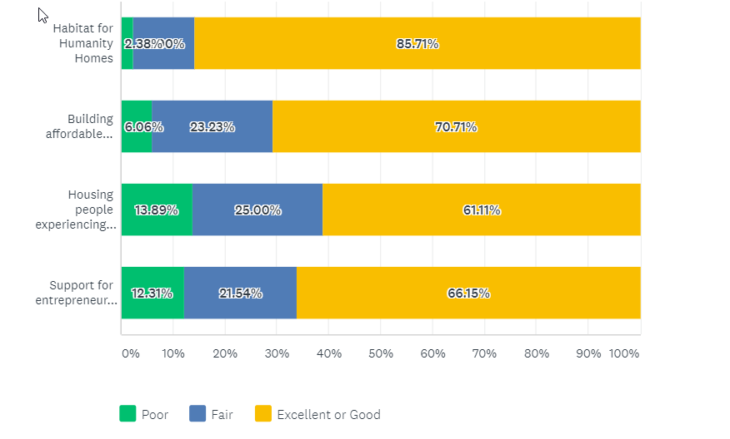
Rate the quality and effectiveness of programs funded by the City.
50% of respondents not familiar with the City’ support to Couleecap and WWBIC to help entrepreneurs

Slide 16
Comments on City projects and funded projects
Love Powell and Poage Parks, commitment to the Southside is excellent
New to the area, haven’t heard of these
Continue to encourage homeownership
Maintain single family neighborhoods with fewer rentals
Would like to know more about the housing rehab program
Better lighting on state street and near UWL
More supervision of properties not obeying city ordinances
City focused on one neighborhood- make it throughout city
I support all efforts to build affordable housing
The City spends to much money on these non-profit programs. Not enough money spent on infrastructure.
The homeless population continues to rise. We don’t have enough resources to house everyone.
I wish I knew more about these programs
Affordable housing is in short supply. Need more housing for middle income housing.

Slide 17
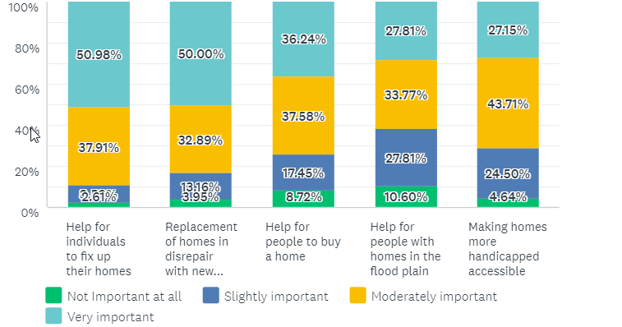
Programs that meet City’s homeownership needs
Notes:
Th

Slide 18
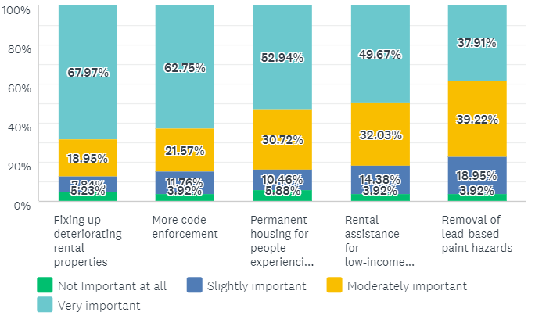
Programs that meet City’s rental needs
Concern for poor quality rentals and code enforcement a higher priority

Slide 19
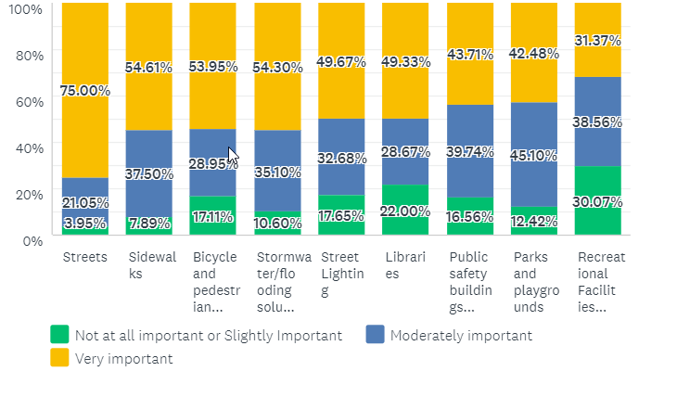
How important are the following capital improvements?
49%
47%
42%
42%
41%
32%
79%
55%
55%
Sidewalks, Bicycle and pedestrian improvements rank higher
Notes:
Everything is generally more important than it was 5 years ago.

Slide 20
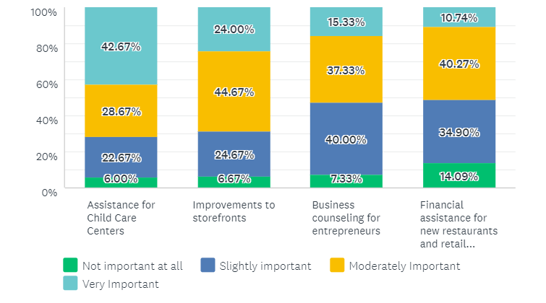
How important are these Economic Development programs?
Notes:
Child care emerges as important and elsewhere in the City , 48% of low income individuals stated this was very important

Slide 21
Overall (% VERY important)
Streets (75%)
Fixing up deteriorating rental properties (67%)
Code Enforcement (62%)
Sidewalks (54%)
Bicycle-pedestrian improvements (54%)
Permanent housing for people experiencing homelessness (52%)

Slide 22
Four (4) types of services that City should prioritize
Notes:
Child care emerges as important and elsewhere in the City

Slide 23
Issues for GENA
Regulation of student rentals (Code Enforcement)
Bicycle, Pedestrian Improvements
La Crosse St
Neighborhood Commercial
Trees, Green Space
Child Care
Data Trends
During the Great Recession, a large number of properties transferred to investors and landlords, many of them out of town. While the economy has bounced back, there isn’t enough supply of homes available for sale.
Finding affordable and quality rental is an issue

Slide 24
GENA Neighborhood
Advocacy around code enforcement at a state level
Bike-ped plan implementation
Support tenant advocacy efforts (tenant resource center)
La Crosse Street (2022)

Slide 25
Next steps for me
Finalize priority areas for Community Development Needs
Continue to strategize on how to bring products to incentivize repairing of existing housing
Coordination with health department on code enforcement
Homelessness
Affordable, quality housing for a variety of income levels
Prioritize lighting projects

Slide 26
Reactions? Questions?
Caroline (Neilsen) Gregerson
Community Development Administrator
608.789.7393 (office)

