Slide 1
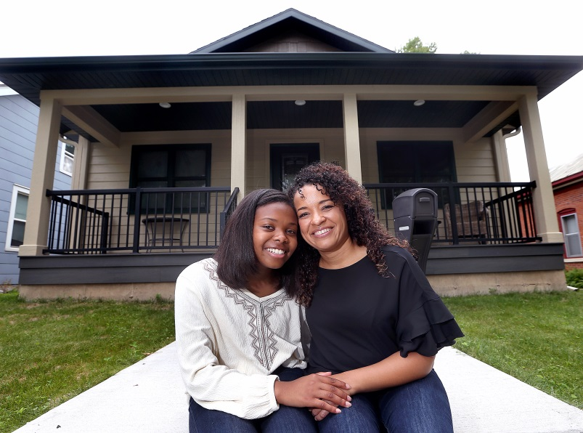
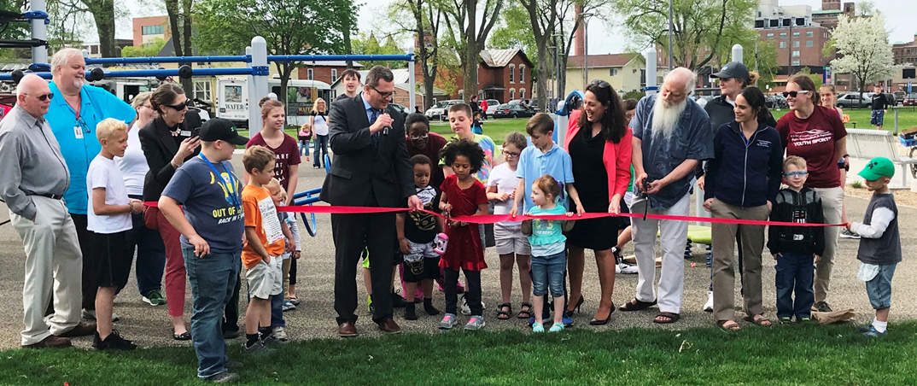
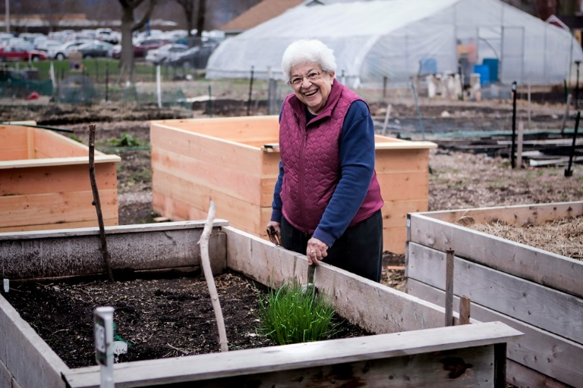
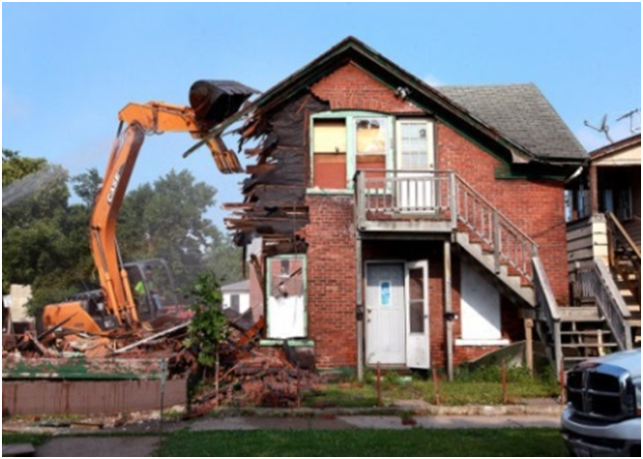
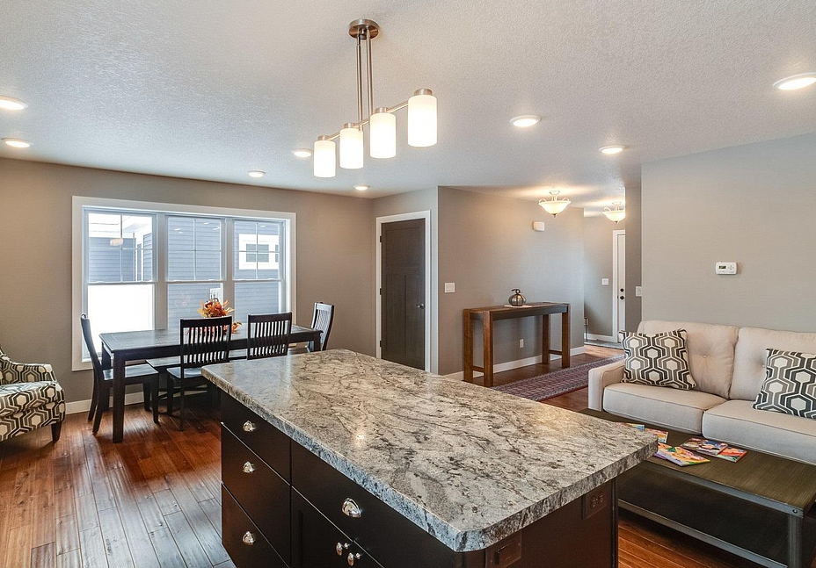
Community Needs Survey
To inform the Community Development Block Grant and HOME
5-year plan – look at how to prioritize our funds

Slide 2
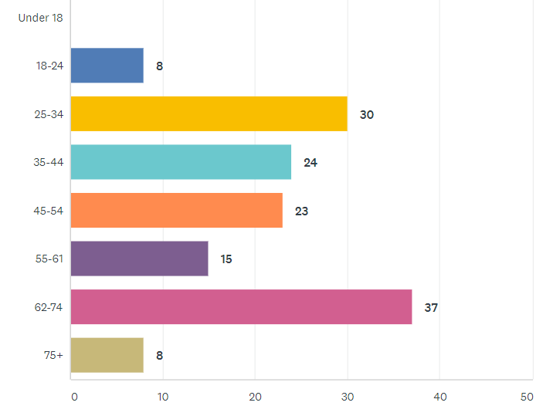
Who took the survey- Age
145 Survey Takers
Notes:
Caroline

Slide 3
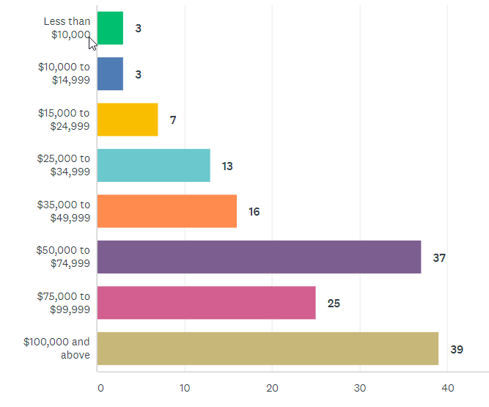
Who took the survey- Income
Notes:
Caroline

Slide 4
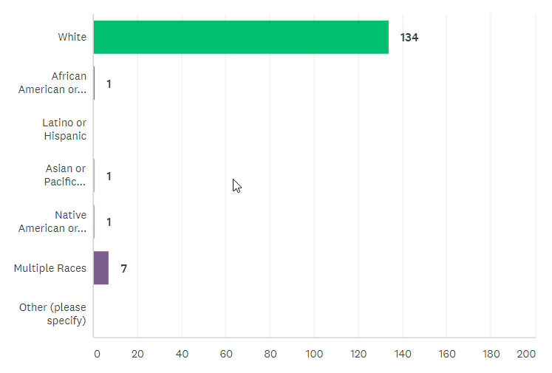
Who took the survey- Race
93% White
Notes:
Caroline

Slide 5
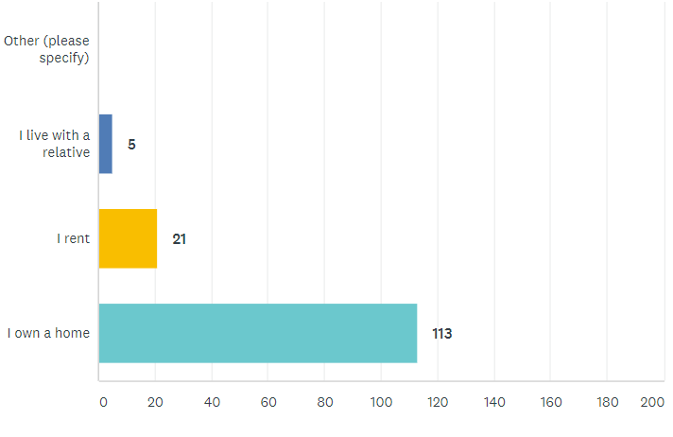
Housing Status
Mainly homeowners (90%)
Notes:
Caroline

Slide 6
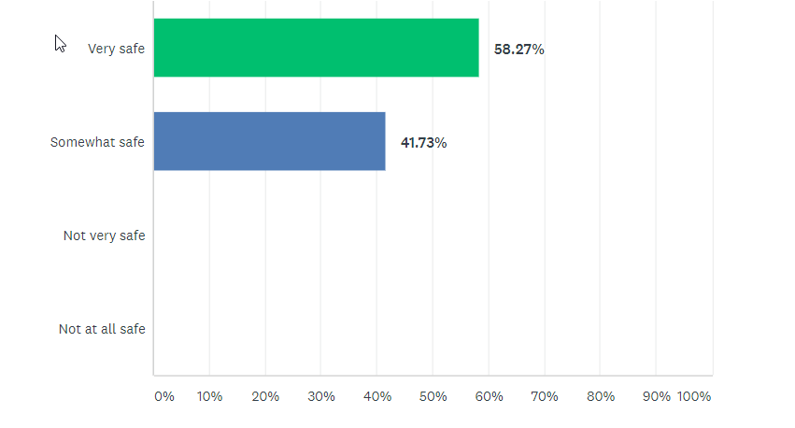
How safe do you feel? (overall)
People feel much safer than in other City neighborhoods
Compared to City-Wide Survey
42% of overall survey takers feel very safe 49% of overall survey takers feel somewhat safe
7% feel not very safe
1% not at all safe
Notes:
Much safer that Powell Poage Hamilton across the street

Slide 7
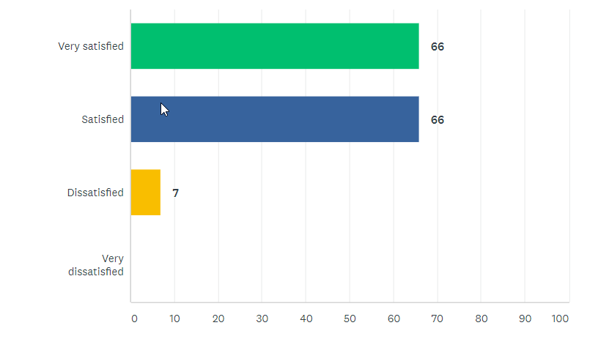
How satisfied do you feel? (overall)
City-Wide
2019 34% feel very satisfied, 51.77% feel satisfied
2014 13% feel very satisfied
Notes:
Caroline or Hetti?

Slide 8
Deep Dive into people who were dissatisfied (7)
Younger (25-34)
A range of incomes, 3/7 over $100k per year
85% white, 14% non-white
6 out of 7 are home-owners
All feel somewhat safe
71% of this group says they are NOT satisfied with streets and sidewalks
57% not satisfied with places to shop and eat
Notes:
Caroline or Hetti?

Slide 9
Deep Dive into people who were dissatisfied (7)
Sidewalks are discontinuous and bike boulevards are rare. Train speed. Festival close but no sidewalks.
Building inspections treatment of landlords.
Roads, curb, gutter on Cliffwood Lane. Flood plain.
Lower taxes, maintain and provide more streetlights, inspectors should look at backyard decks. Move fire department budget to police budget. Fire department paid too much.
Improved law enforcement.
Erickson House on Farnam St.
Notes:
Caroline or Hetti?

Slide 10
What do you like best about your neighborhood?
Notes:
Caroline or Hetti?

Slide 11
What do you like best about your neighborhood?
“Like the feel of the neighborhood. It’s close to everything I need.”
“The neighborhood website (feel safe knowing neighbors). When we go for a walk, most neighbors will talk to you which makes us feel safe.”
“Neighborhood crime watch”
“The neighborhood is quiet, houses are kept well, and there is lots of green”
“We have a wonderful neighborhood association.”
“It feels like a neighborhood , know the neighbors, single family homes, variety of people and incomes. upkeep on homes good.”
“It's a very safe and family oriented neighborhood”
“Having the bluffside in direct view, I have some very friendly neighbors and coworkers in walking distance.”
“Neighbors, proximity to hiking/ running trails”
“It's location; close to trails, marsh, bluffs. It is a quiet street. And my neighbors are lovely”
“View of the bluffs, wooded area, clean”
“Quiet, safe, active, friendly, great families”
“Convenient but safe”
“good mix of small and large homes and young and older families”
Notes:
Caroline or Hetti?

Slide 12
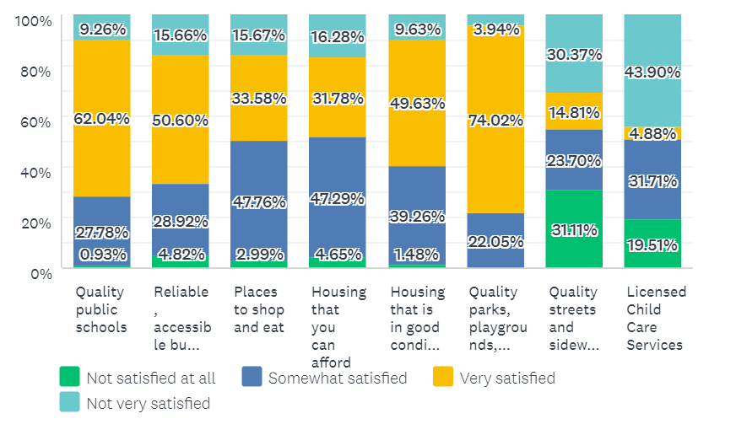
How satisfied are you with your access to the following resources?
Very: quality parks/playgrounds, next 62% schools
Least satisfied: Child care, Quality streets and sidewalks
Somewhat satisfied: places to shop and eat, housing affordability

Slide 13
What would you like to see improved?- Roads, Lighting
56 had no comment here: “No problems”
“We can’t entirely focus on roads. While they are bad, it’s a result of having to many and not being willing to pay for them. We have to be willing to accept that.
Streets (30): referring city-wide, La Crosse St, Losey (previously)
Sewer on 28th St
Addressing potholes, conditions deplorable
Do not like measures to slow traffic on Cass St
Cliffwood St
29th between Main and Cass St
Our street is in need of repair and nothing gets done
Sidewalks and Bicycle Infrastructure
Sidewalks discontinuous not much bike infrastructure
Level sidewalks
Lack of safe routes (sidewalks) for children
Opportunities for accessible shopping and restaurantws
Improved Lighting (111)
Makes it difficult to walk at night

Slide 14
K-Mart
High priority
“urban plight of the neighborhood”
All the retail goes to Onalaska
Concern about safety, speeding
Speedbumps on Losey Blvd
Slow down traffic in neighborhood
Management of rental properties
Complete flood plain study
Pond on 33rd St – mosquitos
Code Enforcement
Neighbors trimming bushes and cutting down dead streets
Neighbor with 8 vehicles in his yard and on the street
Child care and Quality Schools
“school quality seems to have gone down quite a bit”
“child care in the city is very challenging”

Slide 15
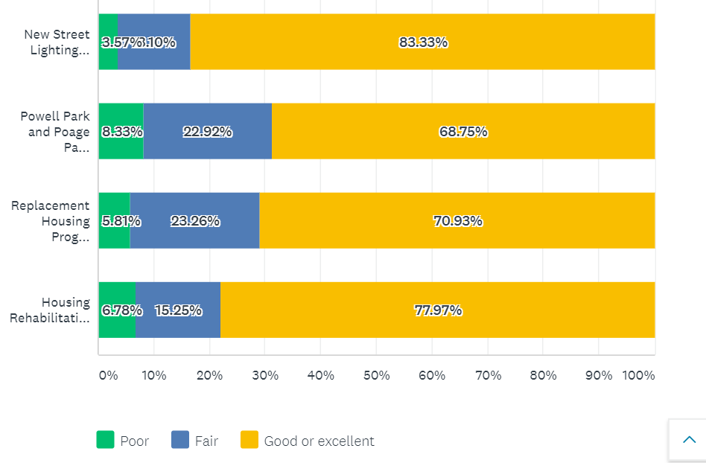
Rate the quality and effectiveness of City programs.
53% of respondents not familiar with the City’ Housing Rehab Program, 32% not familiar with Replacement Housing Program
Notes:
Comments are focus more on housing in PPH and Washburn over parks, some comments negative on Powell and Poage Park, the new homes that are being built are unaffordable, all of them are effective in combination, more street lighting, homes are expensive and falsely advertised, complaint about new occupants of a home, keep up the homes that we are giving them too, advertise the programs better, you can put all the money you want into these neighorhoods but until you tackle drugs and crime it wont do you any good, not enough people use powell park, increase funding to more areas, poage park was built for older kids need equipment for younger kids, more housing incentives for more people, I feel unsafe at powell park, building homes is not the job of government, would like to know more about housing rehabilitation loan program, more work on rehab, money for the northside , negative coments on powell park, wish there was more money for old homes to get fixed up, more dog parks , street lighting is excessive

Slide 16
Comments on City projects and funded projects
Putting in new housing only works if it is affordable housing. Replacing with new and then charging so much that people are forced to go elsewhere isn't really helping those people.
Like upgrades to city parks, especially making them friendly for individuals with disabilities.
Again, the disrepair of streets is the number 1 priority--what good is a nice park or school if the streets look like minefields?
Keep up the good work on the Replacement Housing Program!
It would be nice to know about these programs and what is available to home owners.
While they both needed renovation, I think Powell Park was not used effectively. I drive by regularly and never see kids using the play structure. It is not designed well for younger children. While having a big open field can have its perks its is not well suited for the high traffic area it is in. I feel a wider array of amenities for all ages would greatly increase traffic.
I’d like to see some of the student houses cleaned up around Vine and Pine Street.

Slide 17
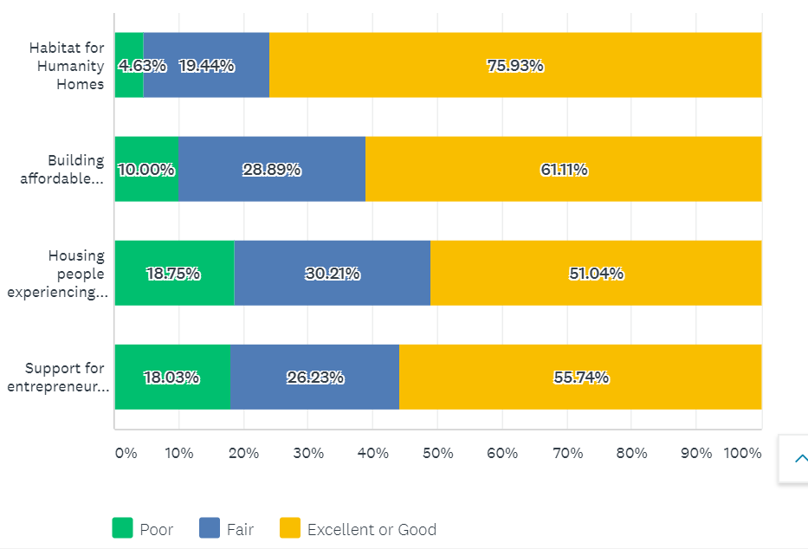
Rate the quality and effectiveness of programs funded by the City.
50% of respondents not familiar with the City’ support to Couleecap and WWBIC to help entrepreneurs

Slide 18
Comments on City projects and funded projects
Would like to see a strong program encouraging the community to move towards a more environmentally conscious lifestyle.
Does our housing support help or just bring in more people with homes (drug related, not need related)?
The newly built apts, condos, windows and 55 plus housing is not affordable for a single person who lives alone.
Finding housing for the homeless needs continued support.
Stop with all the programs and save money and give it back to the people paying property tax. Pretty soon I will have to sell as I can go live other places that are cheaper.
Overtime Habitat Housing construction seems to deteriorate at a rapid rate. The quality of construction and pride of ownership appears to not be the same as a City or Coulee home.
Our homeless problem has increased because of the city taking it upon itself to create and allow more social support programs to support homelessness.

Slide 19
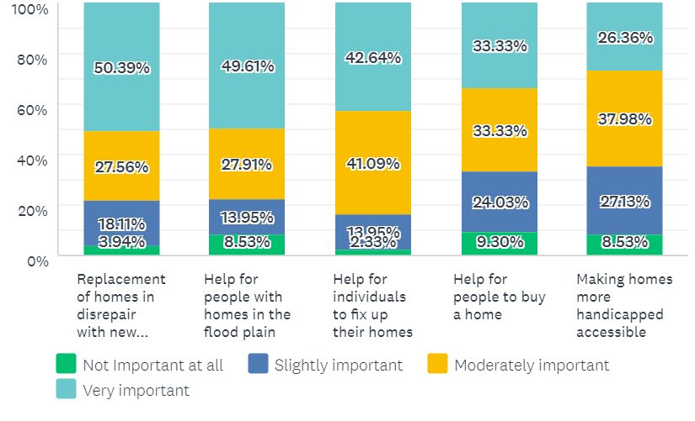
Programs that meet City’s homeownership needs
Notes:
Th

Slide 20
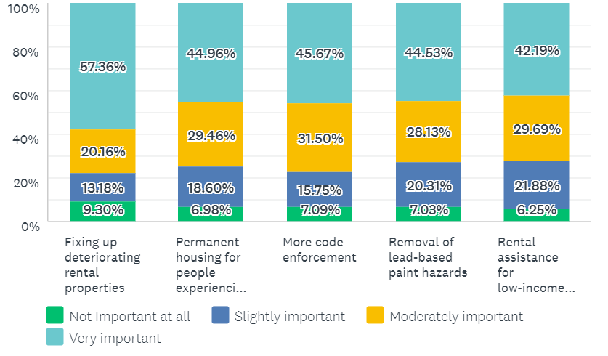
Programs that meet City’s rental needs

Slide 21
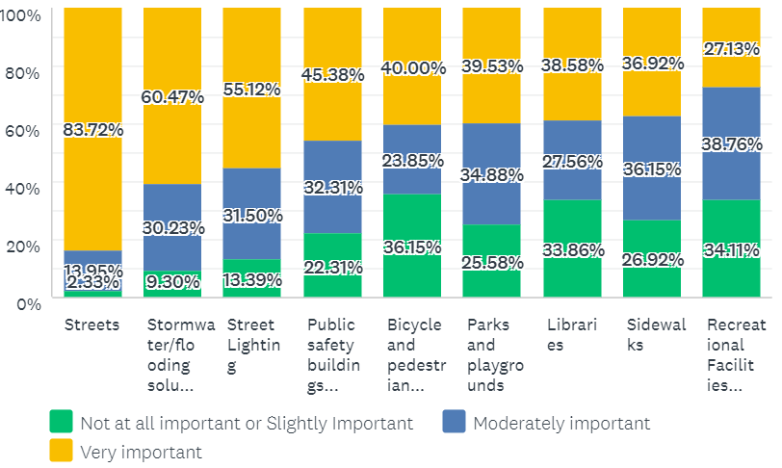
How important are the following capital improvements?
49%
47%
42%
42%
41%
79%
55%
55%
Streets, stormwater/flood, street lighting rank very highly
Sidewalks ranks lower, but frequent comment
Notes:
Everything is generally more important than it was 5 years ago.

Slide 22
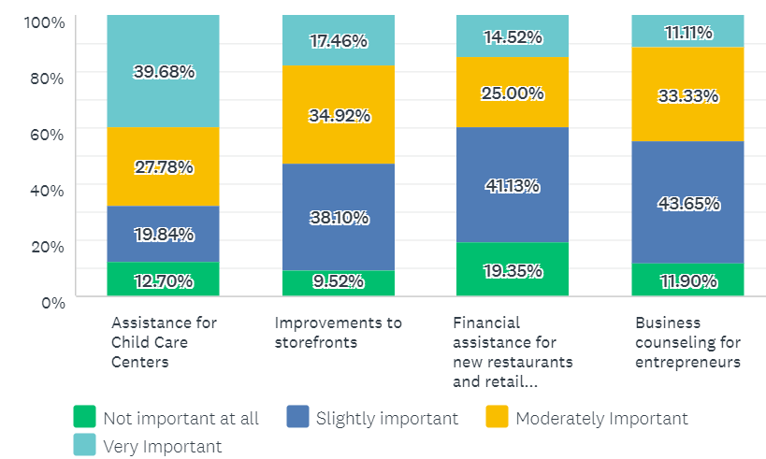
How important are these Economic Development programs?
Notes:
Child care emerges as important and elsewhere in the City , 48% of low income individuals stated this was very important

Slide 23
Overall (% VERY important)
Streets (84%)
Stormwater/flood solutions (60%)
Fixing up deteriorating rental properties (57%)
Street lighting (55%)
Replacement of homes in disrepair with new housing (50%)

Slide 24
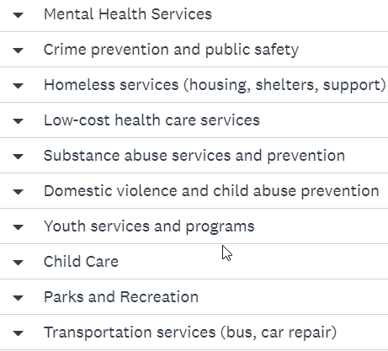
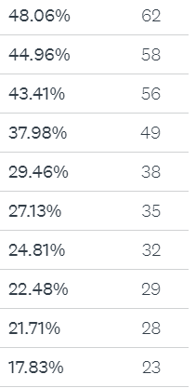
Four (4) types of services that City should prioritize
Notes:
Child care emerges as important and elsewhere in the City

Slide 25
Issues for Bluffside
Streets
Senior Center, meeting needs of Seniors
Child Care, Family amenties
Crossings (Losey), traffic Losey
K-Mart Site
Sidewalks (ranked lower but frequent comment)
Homelessness (city-wide)
Lighting

Slide 26
I am proud to be part of this city. Sure there are things that could be improved but the city is working to grow in a positive way and help its people. Thank you.

Slide 27
Next steps for me
Finalize priority areas for Community Development Needs
Continue to strategize on how to bring products to incentivize repairing of existing housing
Coordination with health department on code enforcement
Homelessness
Affordable, quality housing for a variety of income levels
Prioritize lighting projects

Slide 28
Reactions? Questions?
Caroline (Neilsen) Gregerson
Community Development Administrator
608.789.7393 (office)

