Slide 1
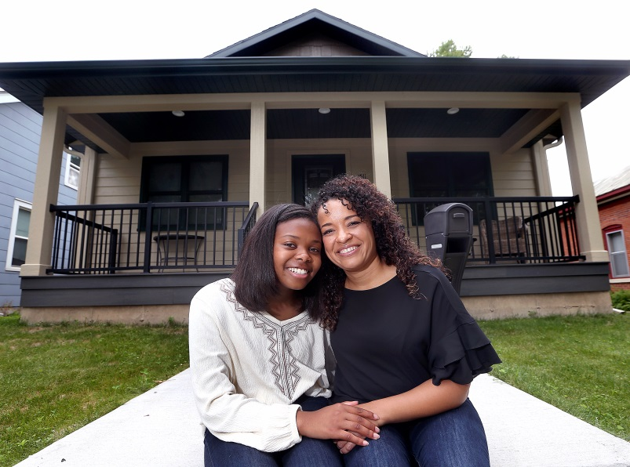
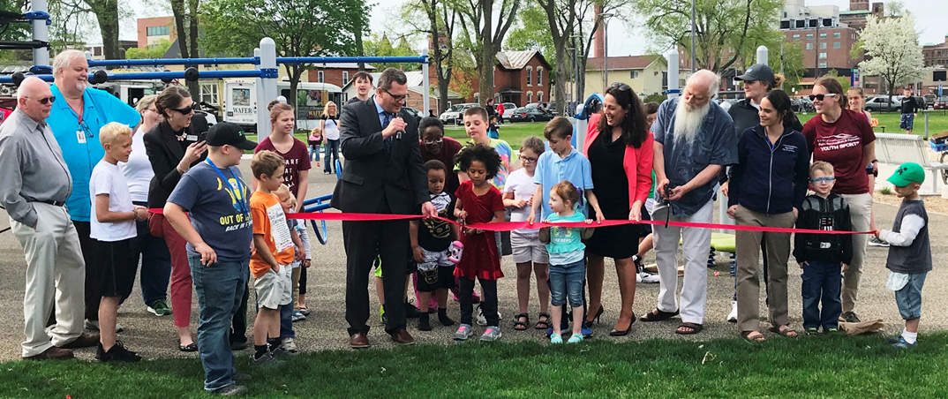
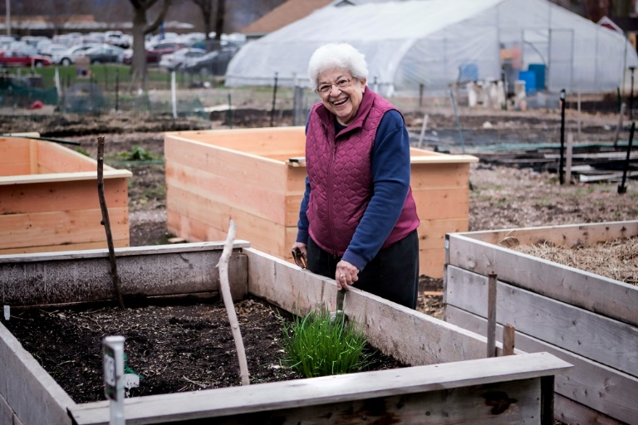
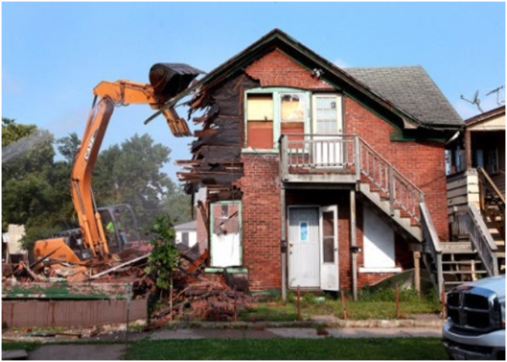
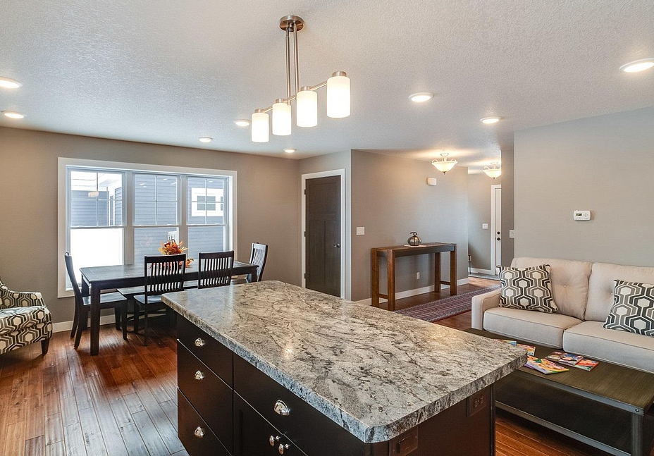
Community Needs Survey
To inform the Community Development Block Grant and HOME
5-year plan – look at how to prioritize our funds
Filtered to Hintgen Neighborhood

Slide 2
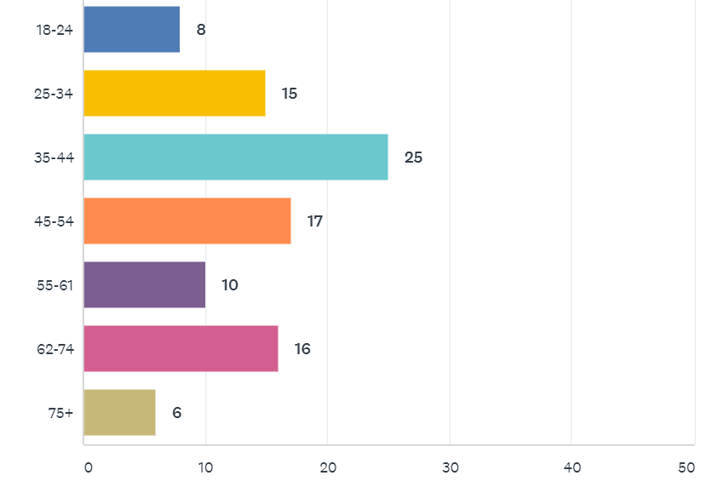
Who took the survey- Age
96 Survey Takers
Notes:
Caroline

Slide 3
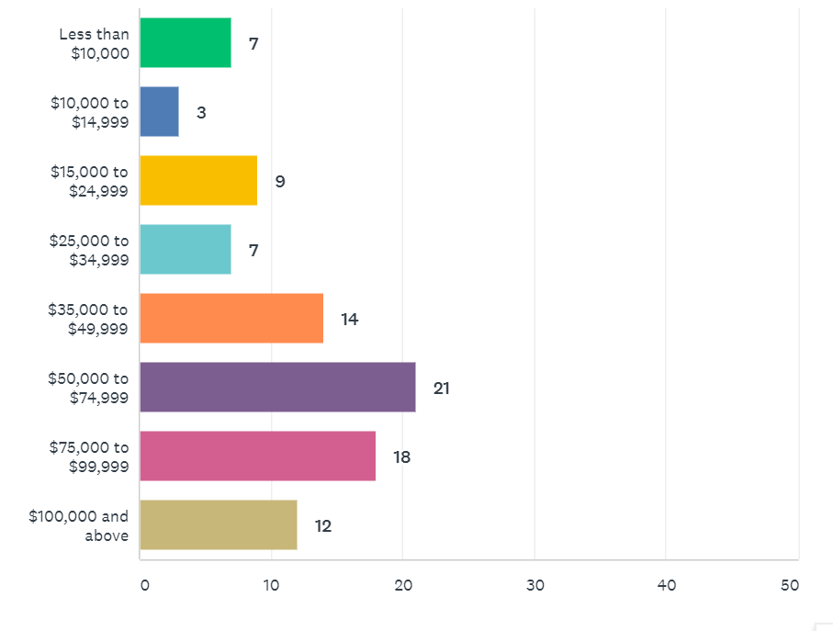
Who took the survey- Income
Notes:
Caroline

Slide 4
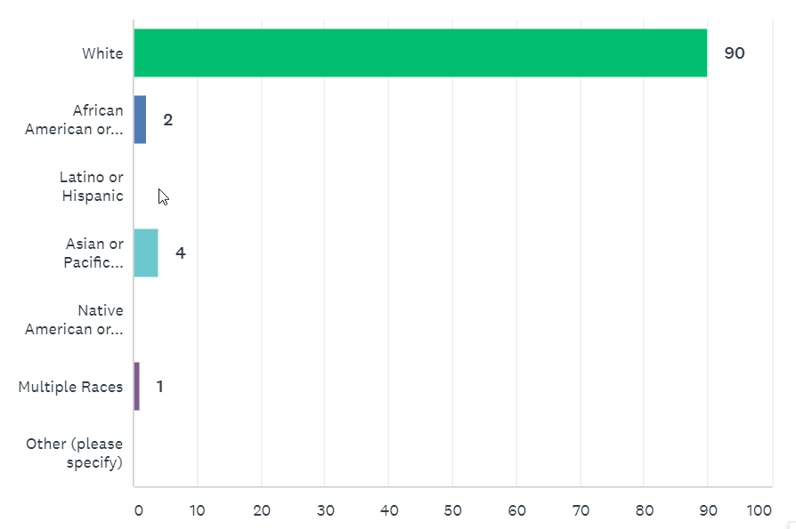
Who took the survey- Race
93% White
Notes:
Caroline

Slide 5
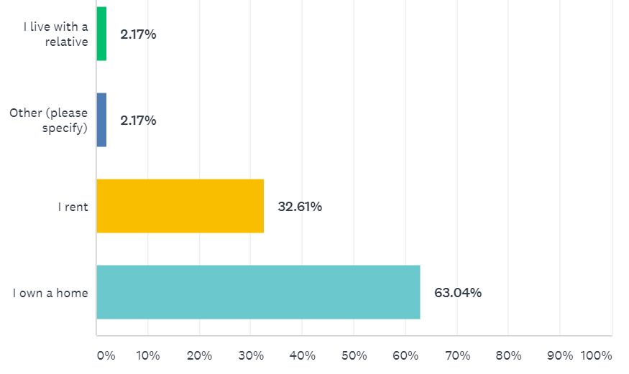
Housing Status
Notes:
Caroline

Slide 6
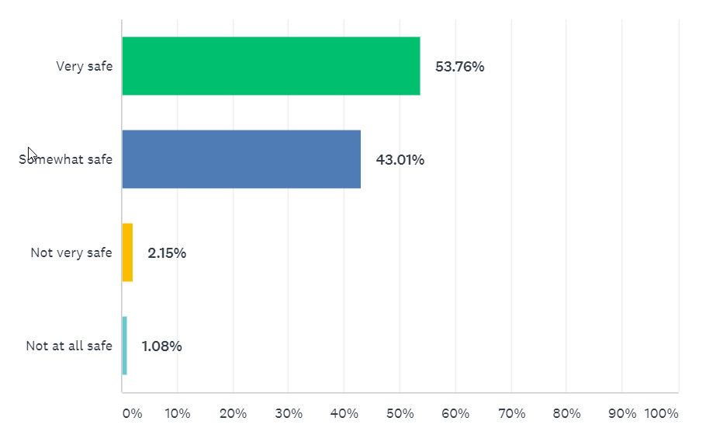
How safe do you feel? (overall)
Safer than in other City neighborhoods
Compared to City-Wide Survey
42% of overall survey takers feel very safe 49% of overall survey takers feel somewhat safe
7% feel not very safe
1% not at all safe
Notes:
Much safer that Powell Poage Hamilton across the street

Slide 7
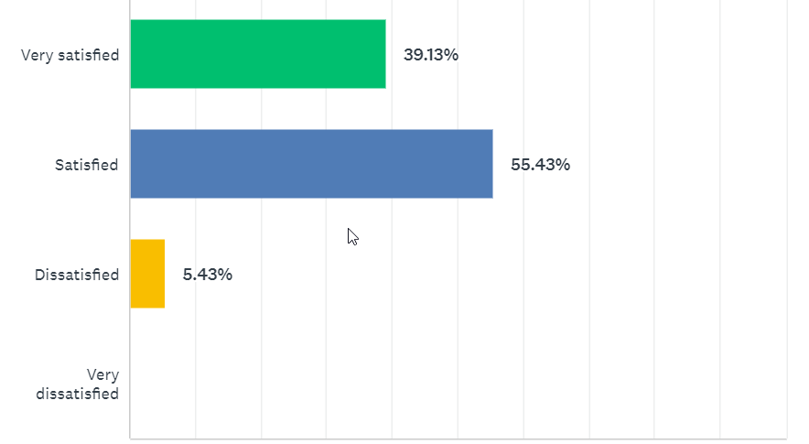
How satisfied do you feel? (overall)
5 residents dissatisfied
Streets
Taxation (foot the bill for the surrounding areas)
Sidewalks (there was supposed to be sidewalks but then the funds when away)
Safety
City-Wide
2019 34% feel very satisfied, 51.77% feel satisfied
2014 13% feel very satisfied
Notes:
Caroline or Hetti?

Slide 8
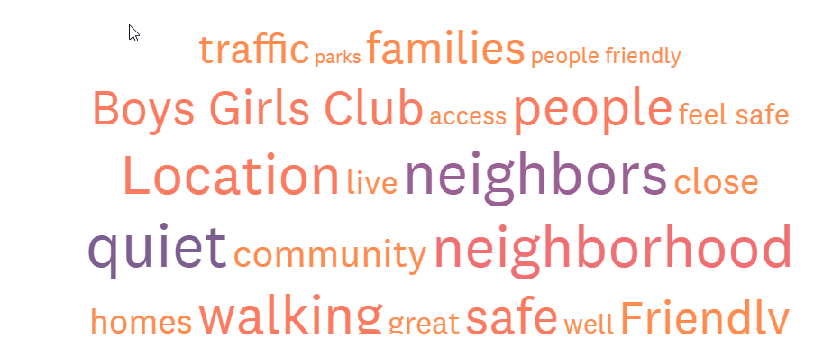
What do you like best about your neighborhood?
Notes:
Caroline or Hetti?

Slide 9
What do you like best about your neighborhood?
“Great neighbors, 2-3 miles away to get gas or food, near parks, bowling, high-roller”
“Near Wal-Mart, Quiet neighborhood.”
“The Boys and Girls Club”
“Close to stores, family oriented”
“The school, parks.”
“Quiet and the neighborhood is improving.”
“It's a very safe and family oriented neighborhood”
“location and convenience to grocery stores, etc. people are friendly, watch out for others”
“Quiet and little traffic”
“Well-kept and peaceful”
“great neighbors, close access to stores and restaurants”
“Neighbors. Proximity to church and grocery store”
“Everyone watches out for the neighbors young and old.”
“Near nature”
“People are very friendly and welcoming. I feel pretty safe in this area”
Notes:
Caroline or Hetti?

Slide 10
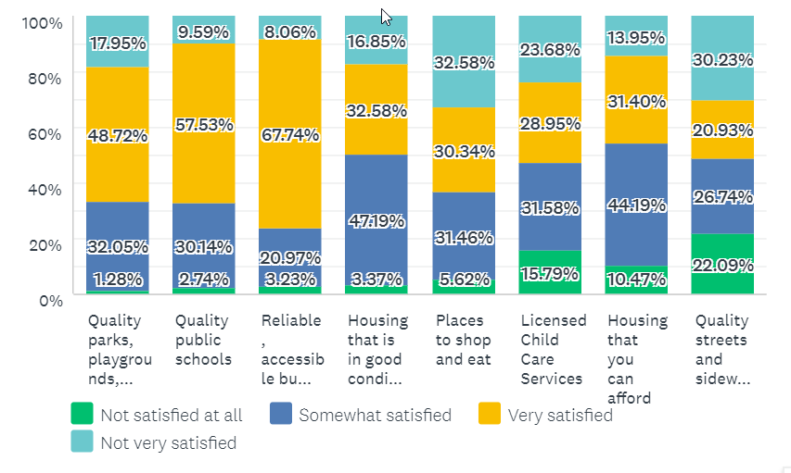
How satisfied are you with your access to the following resources?
Very: Bus service, quality public schools, parks/playgrounds
Somewhat: Housing affordability, housing quality
Lease: Quality street and sidewalks, licensed child care, places to shop and eat

Slide 11
What would you like to see improved? (48 comments)
Streets
referring city-wide, Losey
Neglected infrastructure in exchange for “feel good projects”
Prioritize less polluting vehicles
Slow down traffic
Cars drive too fast through neighborhoods (Gladys Court)
Speeding on Mormon Coulee Road
Vs. remove (roundabouts) to slow down traffic (11)
Street Crossing
South Avenue difficult to cross
Sidewalks, Improved Lighting
We have very few sidewalks, not walkable (111).
More Bicycle lanes, protected bike lands on South Ave and Losey
Lighting near public housing
“I turn into pure black”
Playground
Upgraded playground near public housing (11)
A new “real” park with plants and flowers (not rubber playgrounds)
At school- needs of children better met to support teachers
More child care facilities, child care that’s affordable
Housing- keeping homes up on the exterior, more code enforcement
hard to find rent that is affordable (1)
Policing- more police visibility, more meet and greets with police
Property taxes- lower
Lack of restaurants besides fast food

Slide 12
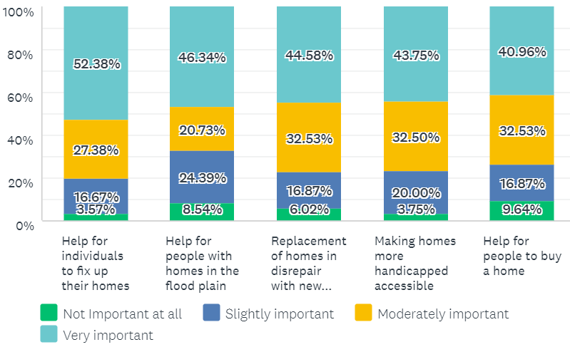
Programs that meet City’s homeownership needs
Help for individuals to fix up their home ranks the highest but not as strongly supported as older neighborhoods
Notes:
Th

Slide 13
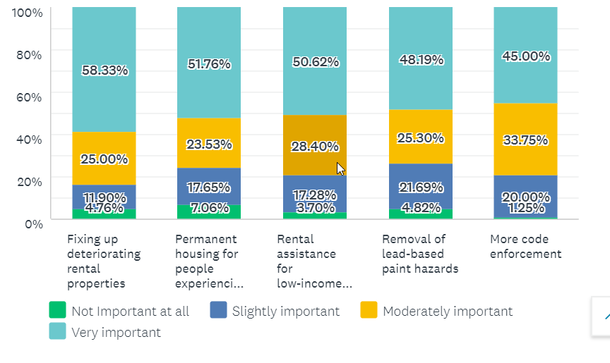
Programs that meet City’s rental needs
Fixing up deteriorating rental properties ranks the highest but not as strongly supported as older neighborhoods

Slide 14
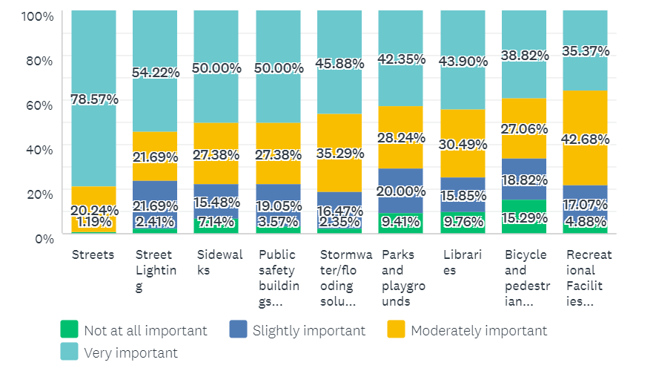
How important are the following capital improvements?
49%
47%
42%
42%
41%
79%
55%
55%
Streets, sidewalks, street lighting rank very highly
Sidewalks ranks 3rd, but frequent comment
Notes:
Everything is generally more important than it was 5 years ago.

Slide 15
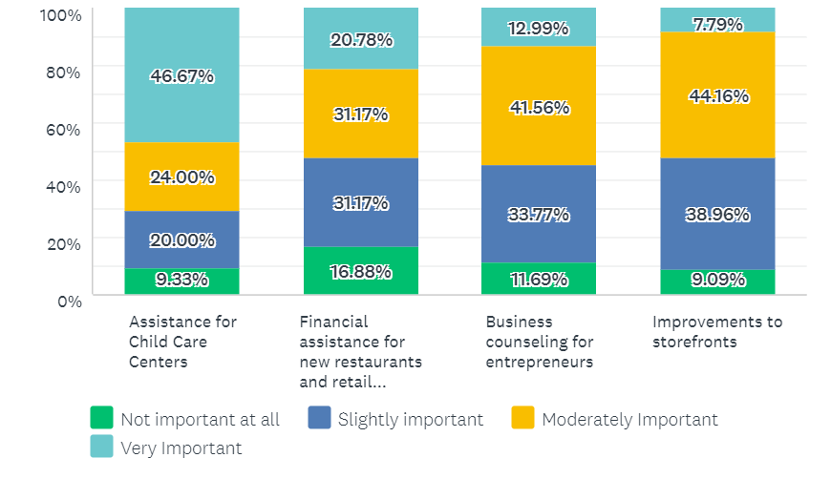
How important are these Economic Development programs?
Assistance for child care centers ranks very highly
Notes:
Child care emerges as important and elsewhere in the City , 48% of low income individuals stated this was very important

Slide 16
Overall (% VERY important)
Streets (78%)
Fixing up deteriorating rental properties (58%)
Streetlighting (54%)
Help for individuals to fix up their homes (52%)
Permanent housing for people experiencing homelessness (52%)
Tie for 6th
Rental assistance for low-income families
Sidewalks
Public Safety Buildings

Slide 17
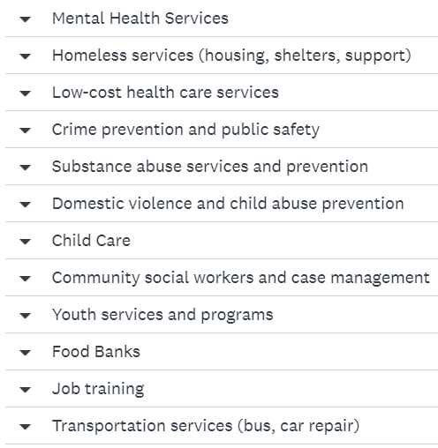
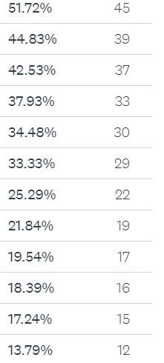
Four (4) types of services that City should prioritize
Notes:
Child care emerges as important and elsewhere in the City

Slide 18
Other Comments (29)
Harry J Olson Center, Senior Center
“I work with families in rentals that are unsafe. There rarely seem to be consequences for landlords.”
Fix the streets, main road potholes should be filled without contacting street department
Child care close to home
Landlords should be 100% responsible for upkeep of their building. Lower residential property taxes, police presence, assistance to people for child care and housing for someone who can work full time at a job.
Get a good business in the former Kmart and Shopko. Need something more than Wal Mart.
Need sidewalks.
Bring back Myrick Park. Start with the duck house and go from there.
Lights by the A&W for crossing, signs on Lang Drive crossing, more restaurants
Street and sewer repair
Assistance to home owners for housing repairs
More single family homes that lower-middle income people can afford
Funding for those struggling with addiction
House the homeless and fix the potholes
Reduce Carbon Emissions, rehab (not demolition)
Housing that affordable for people living in poverty
The policemen that patrol the neighborhood should introduce themselves
Housing is not affordable at all, someone working on minimum wage cannot afford a one-bedroom home
More single family homes
Be cautious with our tax money

Slide 19
Next steps for City
Prioritize needs identified in the survey
Programs for homes
Ideas For Neighborhood
Identify priority streets in neighborhood and priority safer crossings
Identify locations for sidewalks and request through CIP budget
Lighting near public housing or other areas
Reach out to police department with feedback or to attend a neighborhood association meeting
Traffic calming measures near public housing
Parks?

Slide 20
Reactions? Questions?
Caroline (Neilsen) Gregerson
Community Development Administrator
608.789.7393 (office)

