Slide 1
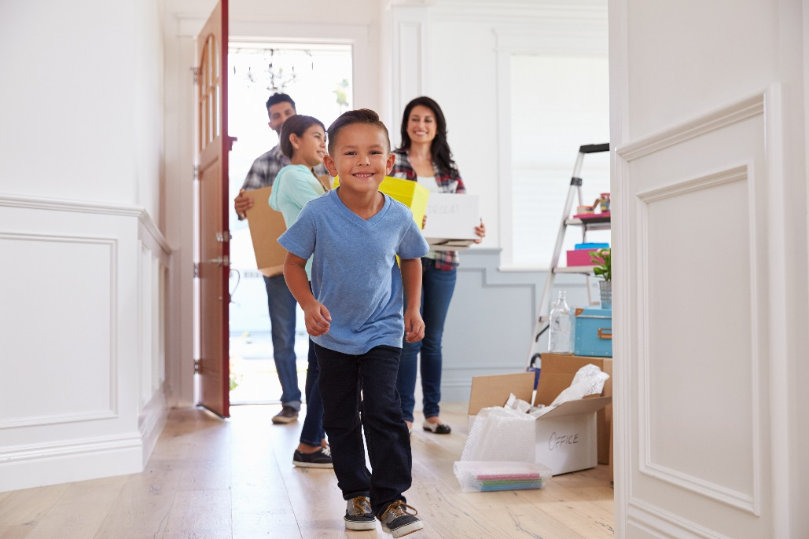
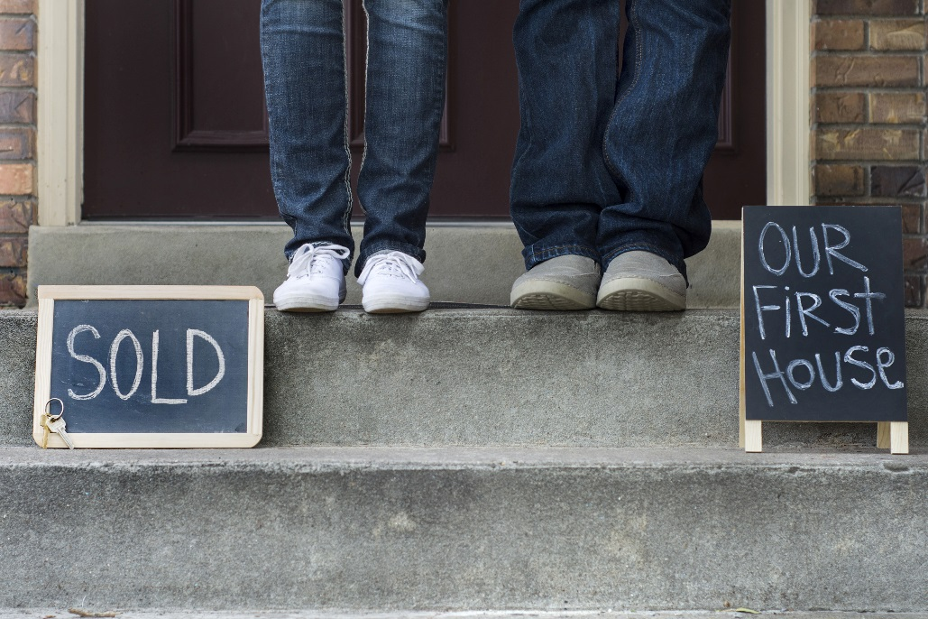
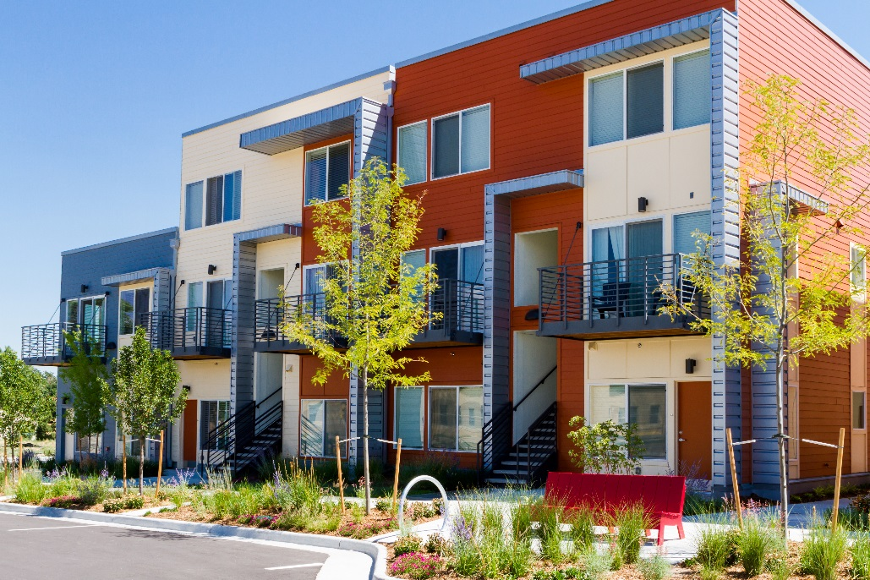
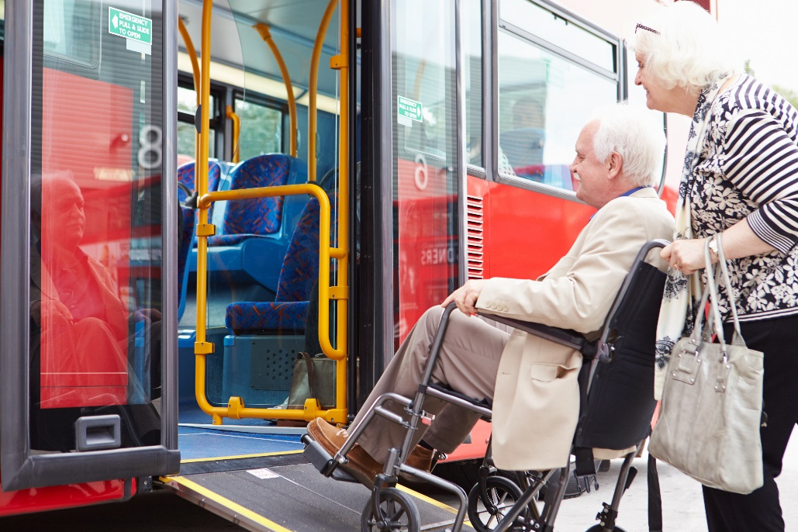
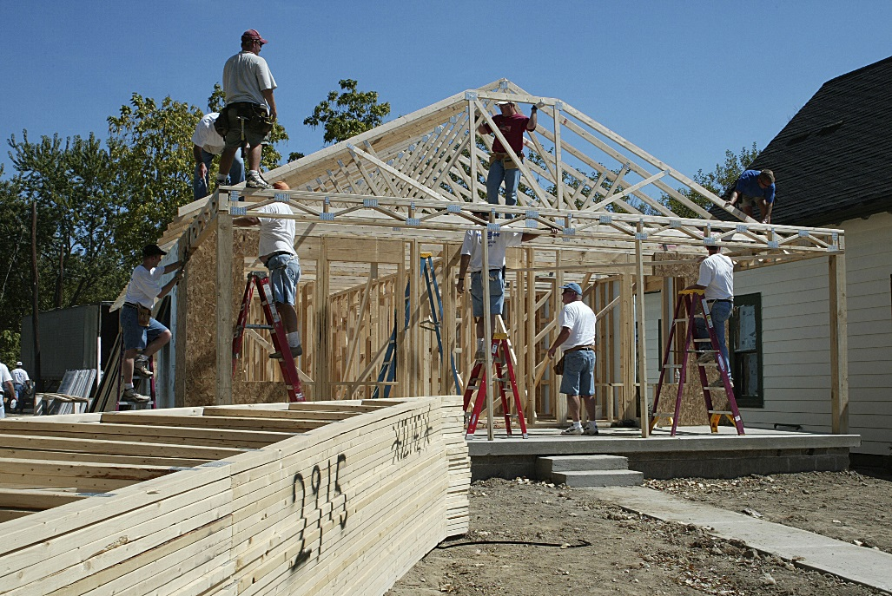
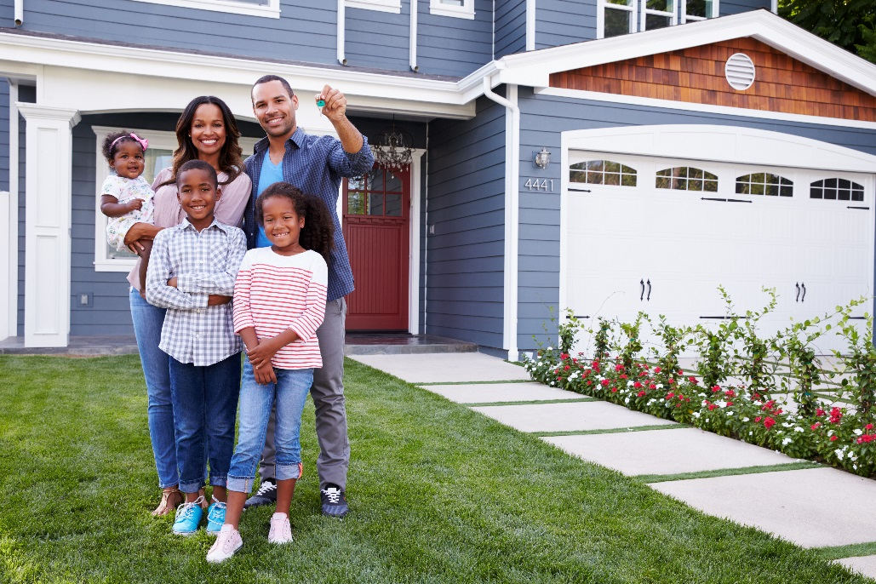
Community Needs Survey
To inform the Community Development Block Grant and HOME
5-year plan – look at how to prioritize our funds

Slide 2
A look back in time ….. 2013
Important Outcomes from a Neighborhood Plan
More police presence and safety
Improving the housing, more single family homes
More lighting
Better care of parks
Improve the look of the neighborhood
Notes:
Caroline

Slide 3
Engagement
Door to door surveying in PPH/Washburn
School Open House and Parent-Teacher Conferences
Neighborhood Associations
Facebook Advertising
Field of Screams (Halloween Event)
Eagle Crest South
Landlord Association Meeting
Public Housing in Washburn and Northside
Notes:
Caroline

Slide 4
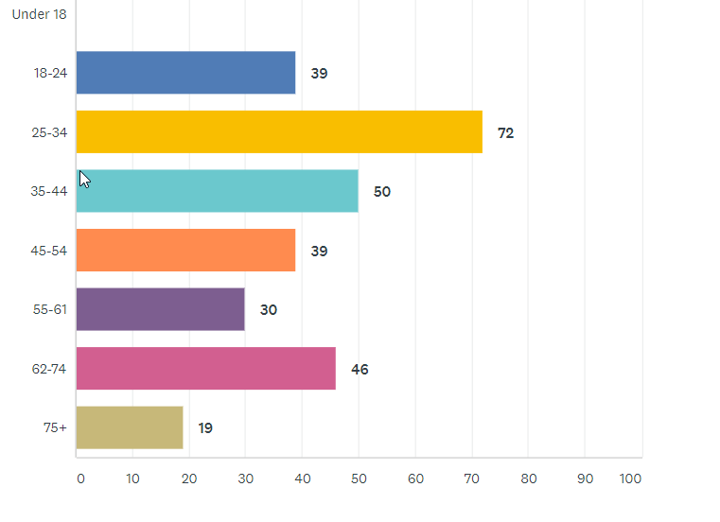
Who took the survey- Age
171 Powell Poage Hamilton
126 Washburn
297 (total)
Notes:
Caroline

Slide 5
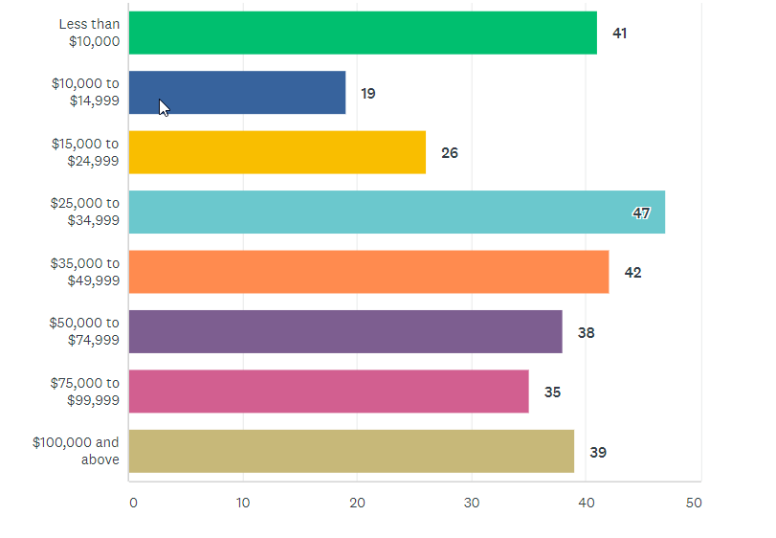
Who took the survey- Income
Notes:
Caroline

Slide 6
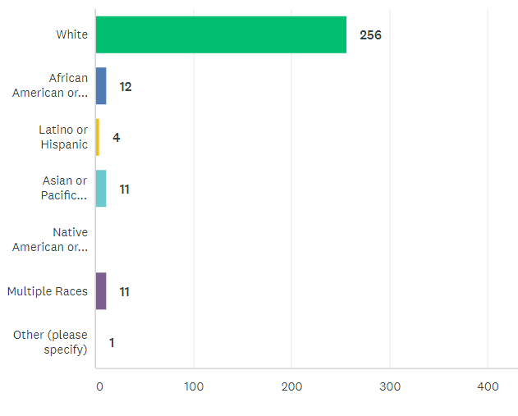
Who took the survey- Race
Notes:
Caroline

Slide 7
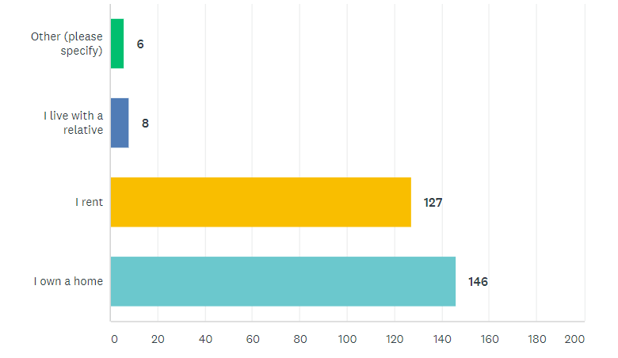
Housing Status
Notes:
Caroline

Slide 8
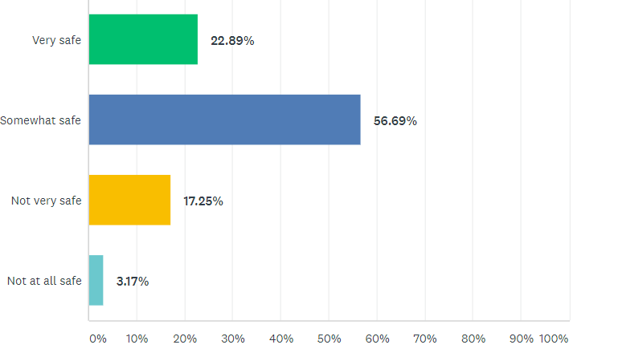
How safe do you feel? (overall)
Compared to City-Wide Survey
42% of overall survey takers feel very safe (less safe that city-wide)
49% of overall survey takers feel somewhat safe
7% feel not very safe
1% not at all safe
Safety about the same as Northside
Notes:
Caroline or Hetti?

Slide 9
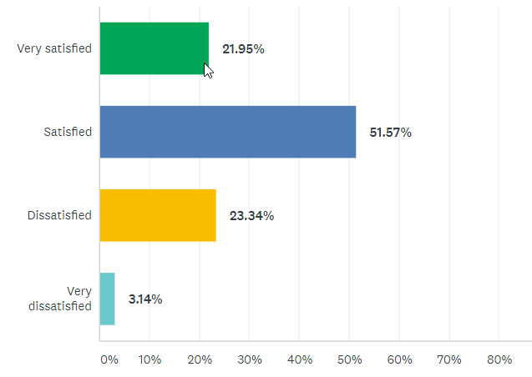
How satisfied do you feel? (overall)
City-Wide
2019 34% feel very satisfied
52% satisfied, 12% dissatisfied, 1% very dissatisfied
Northside
18% Very satisfied, 58% Satisfied, 20% dissatisfied 3% very dissatisfied
Notes:
Caroline or Hetti?

Slide 10
What do you like best about your neighborhood?
Notes:
Caroline or Hetti?

Slide 11
Powell Poage Hamilton- Washburn
Quiet and nice neighbors
Location- close to schools and amenities
Good neighbors, well kept homes, friendly, quiet
Neighbors are great
Improving
Improvement in lighting
School district
Close to work, within walking distance, convenience, clos
Know my neighbors, feel safe, will help each other out.
The extra lighting
improvements have been made like condemning properties and putting up new properties. La Crosse Promise is a good ideas. I like the location, centrally located. Attempt to improve
the improvement efforts being made, accessibility to everything I need
Our immediate neighbors - friendly & helpful
The mix of income levels, race and ethnicity
Close to work and downtown. During fair weather do not need a car
Its kinda hood right now. I get to be the tip of the gentrification spear
Diversity
Neighborhood is improving due to Promise Program and addition of street lights
New homes are being built
Inexpensive, low cost
really cheap to rent house
the park, neighborhood association
social class mix
Our neighborhood resource officer program has been a great help with issues experienced in our area. Parks in our area are also great!
Small, diversity, comfortable
Notes:
Caroline or Hetti?

Slide 12
Northside
Quiet (49)
Neighbors and people (45)
Close, Location, and Convenient (57)
Schools (29)
Parks and playground (14)
Familiarity and lived here for a long time (17)
New young families moving here , single family homes
Walkability
Close to grocery stores, shopping, public transit
Being on the parade route
Tree-lined streets
Notes:
Caroline or Hetti?

Slide 13
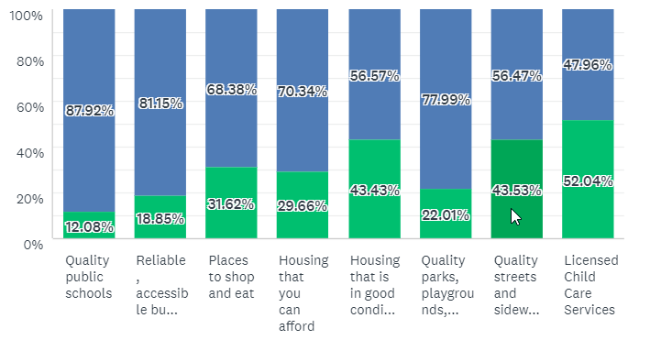
How satisfied are you with your access to the following resources?
Powell Poage Hamilton neighborhood much less satisfied with places to shop and eat
Washburn neighborhood less satisfied with housing condition
38% dissatisfaction with places to shop and eat for Northside.
Housing affordability in Northside 35% dissatisfied (higher), GENA (10%)

Slide 14
Deep Dive into people who are dissatisfied (75)
A range of incomes, with 23 earning over $75,000 per year and 21 earning less than $25,000 per year
85% white, 15% non-white
52% home-owners
26 somewhat safe, 42 not very safe, 7 not at all safe
72% of this group says they are NOT satisfied with housing quality
Notes:
Caroline or Hetti?

Slide 15
Deep Dive into people who are dissatisfied (75)
Neighbors screaming at their children, aggressive neighbors
Personal theft from my porch and yard
Sketchy people in my alley
Neighbors don’t shovel
Drug houses
Gun shootings, violent fights, drug dealing, theft, fear for my safety (Promise family)
Safety
Lighting (like other parts of neighborhood)
Corner grocery store/bakery
Better shopping, better roads
Better maintained and safer housing, improving rentals
More police
Notes:
Caroline or Hetti?

Slide 16
What would you like to see improved? – PPH Washburn
Street replacement at 10th and Farnam
Community center lighting
Pot holes
Mufflers for cars
Police chases
Child care is expensive
Wish people were friendlier
To have neighborhood more updated, clean up. Love all new developments.
A place to shop and eat would be nice the older I get.
New homes needs owners that take pride in their homes
more restaurants and shopping
Remove drug houses and house of ill repute.
fewer rental properties
There are lots of elderly folks. We need a neighborhood grocery store and a place to eat
more rich people movin to the PPH
Need to continue removing blighted homes and apartments. Prioritize single family housing.
more police patrol in the evenings
More lighting
Parking from Gundersen
Separate lanes for bicycles, greater sense of community
grocery stores, restaurants to walk to, breakfast
there are beautiful new homes being built in the area, but are over priced for the neighborhood
I just like to see the homes being better maintained and safer
More affordable family housing in my area that families can rent. Also if they are nice not run down and disgusting
The state of affordable housing in La Crosse is abysmal. The houses in my neighborhood are not cared for. My house alone is awful from the foundation to the floor to the roof.
Notes:
Caroline or Hetti?

Slide 17
What would you like to see improved?- PPH Washburn
I would like to have adequate lighting added to deter crime. I would like the city to crack down on drug dealers. I would like local zoning laws enforced - such as not turning single family dwellings into rentals. By not enforcing these ordinances, neighborhoods are being devalued.
place to see whats going on, post events
monitoring speed of traffic near schools and parks
More street lights . Less rental properties..
If the city is wanting to better the Hamilton area, please reconsider changing the name of “Hood” Street. I live on Hood street, and that name has such a negative connotation to the area.
Access to locally sourced food and goods within walking distance
The new streetlights are horrible, no real bike trails. Food desert.
More shopping and nicer restaurants, more quality affordable housing
Fix the roads, do something about people dropping used needles everywhere and lock the methheads up
Lighting, potholes, trees on boulevards being planted with fruit trees. Have more free accessibility to free fresh fruits. Parks with planters that grow vegetables and fruit trees
Safety of the neighborhood.
Rental housing is in poor condition or just way too expensive for.nicer options
What we need is an inexpensive place to shop for food. Like an Aldi's but better. Festival foods and Kwik Trips are nice, but way too expensive.
Crime is on the rise(drug related) and the streets are a mess.
Garbage from neighbors
More police presence
Notes:
Caroline or Hetti?

Slide 18
Improved– Northside
Police need to patrol more. Children finding needles in the school playground, sidewalks, allys.
Police need to be more responsive.
Need restaurants and affordable housing
Crime and pockets of bad areas and drugs. More police presence.
Better lighting and safety. More use of the parks.
Need a Grocery Store.
Cunningham Street needs to be fixed.
More street lighting (mentioned a lot)
Improvements to Bridgeview Plaza.
Upkeep of homes
Wittenberg Park in poor condition.
Potholes.
More restaurants, grocery stores, clothing stores, since the loss of Bridgeview Plaza.
Small rental units are not maintained well.
Drugs and homelessness
Fully stocked grocery store available
Crime is bad in our area by Gordys

Slide 19
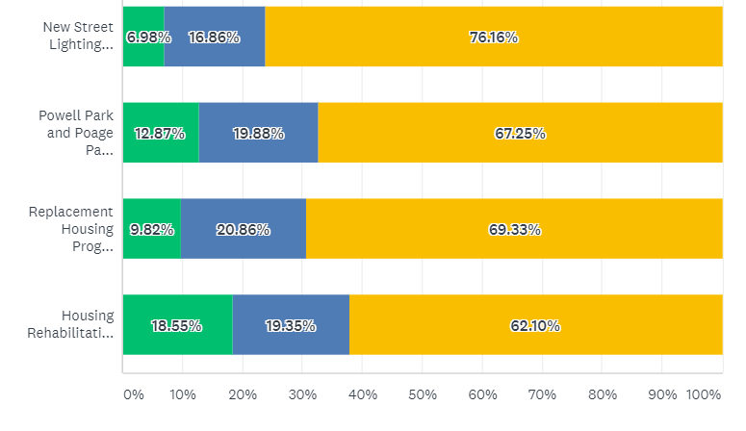
Rate the quality and effectiveness of City programs.
Powell Poage Hamilton Neighborhood only: Replacement Housing 74% good or excellent, Lighting 79%, Park improvements 73%, Northside lower
Notes:
Comments are focus more on housing in PPH and Washburn over parks, some comments negative on Powell and Poage Park, the new homes that are being built are unaffordable, all of them are effective in combination, more street lighting, homes are expensive and falsely advertised, complaint about new occupants of a home, keep up the homes that we are giving them too, advertise the programs better, you can put all the money you want into these neighorhoods but until you tackle drugs and crime it wont do you any good, not enough people use powell park, increase funding to more areas, poage park was built for older kids need equipment for younger kids, more housing incentives for more people, I feel unsafe at powell park, building homes is not the job of government, would like to know more about housing rehabilitation loan program, more work on rehab, money for the northside , negative coments on powell park, wish there was more money for old homes to get fixed up, more dog parks , street lighting is excessive

Slide 20
Comments
All streets in this area should have the new street lighting - Denton, Redfield etc
More is need in Powel, Poage, Hamilton. Replace the trees that were removed in 2018 due to Emerald Ash Borer. Fix streets and sidewalks. Have Parking Authority give tickets to cars parked to close to curb cut outs.
I would like to see more lighting projects around Powell Park.
More replacement homes closer together
Very impressed with projects.
The Park have nothing for teens.. the home program are too expensive
My opinion is some of the houses, SOME, were not so bad and could have been renovated to just as good a standard. Don`t get me wrong, there is a nice improvement in my neighborhood, as far as looks. The parks I think was a waste of money, you could have improved them in other ways, just as they were and made them just as usable.
I hope you stop with the street lighting at 7th street. I am not impress with lighting. bright light at spot of light many more shadows as you move away
Need more Grants to fix up old homes
The rate at which lacrosse is building homes is not fast enough to keep up with our population increase
Notes:
Caroline or Hetti?

Slide 21
Comments
Keep up the good work, it has not gone unnoticed
While it is difficult not to see the value of these housing programs and to congratulate the city's attempt to revitalize struggling neighborhoods, I think there needs to, locked into the purchasing of these homes, a modicum of neighborly etiquette enforced. We have new home that was purchased in our neighborhood. Many people are living in it (clearly not a single family) and the surrounding neighbors are tasked with cleaning up the trash thrown into the streets - even after they've kindly been asked to stop this behavior from several long-time residents.
You just spent millions of dollars on these parks and then I received a questionnaire last fall about putting a new basketball court in at Powell park or poage park. That makes no sense.
I dont like the layout of Powell park, and the play structures are so minimal. more picnic tables. another jungle gym, more swings. more.
Poage Park is no longer a great park for young kids. There should be swings and other play things that can be used by younger kids. Also, too many dogs running in the park and the owners do not clean up after them
Too many parks! Street repairs more important
7th street lighting really helped, need to expand this
The new lighting on 7th is disruptive to residents. When there is snow on the ground, it’s practically daylight. My venitian blinds aren’t enough (as they were before new lights) to keep the bedrooms dark for sleeping. The purchase of light blocking curtains was an expense.
Still to many rentals in the Powell Poage neighborhood.
Notes:
Caroline or Hetti?

Slide 22
Comments on City-projects- Northside
Love the lighting by Logan Middle! I would focus on housing over park renovations.
Programs for financial literacy to enable more people to move from renting to homeownership.
Continue to revitalize parks throughout the City, Copeland is a mess, their commitment to the park ends at the outfield fence.
Look at the Senior Center situation.
More programs to build homes in the flood plain
I am not aware of these programs
Definitely keep that program up! I used the home rehab program a few years back and it was so nice to work with them.
Remove and replace homes.
What about low-income people?
More high quality rental housing
Lighting on George St, all of Clinton St from Rose to George, more lighting at Copeland park on Rose St side
More loans or grants for old homes to get fixed up
More lighting, lighting at Public Housing

Slide 23
Comments
Really impressed with what the city is trying to do with housing in Poage Powell area! Getting more people who own their homes and will stay long term is the way to make change.
Excellent use of the money.
I dont care for the fact that you took the ball field out of the park. That was something that brought people to the park. now it is a place for trouble
Most people in these areas cannot buy homes. We need quality family rentals not student housing or apartments in this Powell poage area
Notes:
Caroline or Hetti?

Slide 24
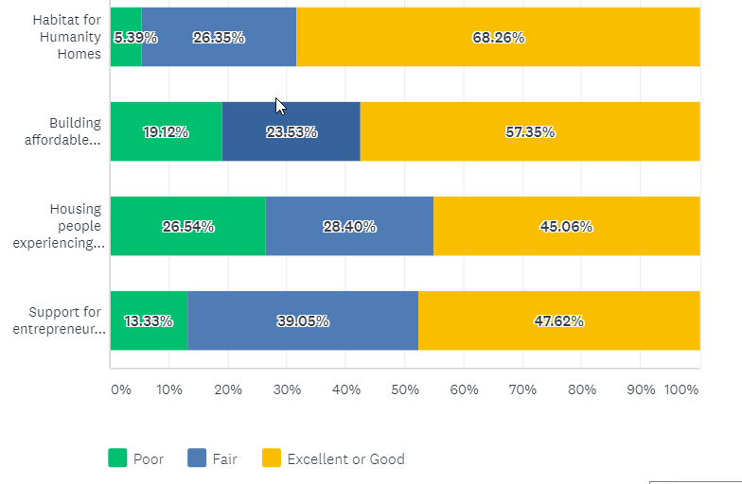
Rate the quality and effectiveness of programs funded by the City.
75% rate it as good or excellent
21% poor
21% fair
59% rate it as good or excellent
24% poor
24% fair
52% rate it as good or excellent
34% fair
51% rate it as good or excellent
Notes:
The City's involvement in improving homelessness by supporting housing is innovative, compassionate, and highly successful.
for the longest time I lived on the upper edge of not qualifying for low income housing. Looking at some of the rates, I still couldn't afford to live at any of the places low income or not
You need to shake things up, you go to the same not for profits hoping for different outcomes, when there are organizations in this community that do more for the same causes. There have been numerous complaints towards CouleeCap and Catholic Charities and have you ever tried calling those places?...its absolutely horrible and you get redirected from person to person and place to place. There needs to be a one stop shop where someone can help that has knowledge. Look into true HUD counselors who do this for a living there are many out there.
Too difficult to obtain decent affordable housing. High rents, individuals with prior legal issues disqualified due to past felony convictions even with proven rehabilitation
The housing built for affordable rentals are still not affordable for most families in La Crosse. The landlords that have worked with the programs to help homelessness are ending up on the list for the nuisance problems because the homeless that they allow to rent from them dont have enough follow up & resources to keep them on the right track. They become a high risk & a financial burden to the landlords that have a heart and want to help. The few that do have caseworkers have to large of a caseload that they dont do the follow up needed, dont communicate with the landlord, and are very little help when problems arise.
As far as affordable housing goes I think a better definition needs to be made. A single mom with 3 kids can’t afford to rent a 3bedroom apartment in one of your affordable housing units.
Couleecap provides extensive and excellent services but Catholic Charities are understaffed and the leadership has been unresponsive to the requests of their volunteers (like me), staff, and their clientele.
Couleecap is a respectable program that assists people in the purchase of their first home and helps others with weatherization. I think this program has definite value in our community. In years past, I volunteered at " The Place of Grace". This was also a valuable asset to the community as well. However, living near "The Place of Grace" has proven that it has become a steady "hang-out" for shady characters who sit and smoke cigarettes for hours on the porch. In my estimation, this is clearly not what this establishment was intended for, and I would like to see it return to its original mission.
City of La Crosse spends too much money on the programs above. There are non-profits that can handle these issues. Not enough money is spent on infrastructure.
I live in Roosevelt school and they are amazing apartments and are very affordable.
I don't know much about these programs what I do know is that I can afford a house of them Habitat for Humanity I can't afford this affordable housing Garden Terrace apartment low income people can't afford this that doesn't mean we're bad people that just means we're living on such a tight budget we can't afford it

Slide 25
Comments on City-funded projects- Northside
I thought we are building affordable housing but I don’t qualify. Single mother of one who crosse $44,000/nets $30,000. Punished for having health insurance with a massive deductible.
Not enough is done in this city for small business and women-owned business.
Define affordable.
We have a serious homeless problem in La Crosse. I hear about the housing programs but they aren’t affordable and the qualifications are impossible.
Too difficult to obtain decent affordable housing. High rents, individuals with prior legal issues disqualified due to past felony convictions even with proven rehabilitation
I live in Roosevelt school and they are amazing apartments and are very affordable.
Do a good job on housing but they end up being to expensive for most
Stop building low-income housing
The apartments next to my house are Couleecap renters. The cops are always there due to problems with them.

Slide 26
Comments on City-funded projects- Northside
I needed help for rent catholic charities said my rents too high for my wages. I pay less than 800 for a tiny 3 bd rm house. I wont get a 2 bd room apt for that in this area. I was so angry.
In regard to homelessness housing...those needing assistance should be able to receive help, but they should also be capable of following through on the necessities of living and maintaining a home or rental...
There is a need for some apartments but I would not say there necessarily affordable and impose some restrictions on income that are unrealistic.
Your programs are driving out the working class. (They make too much for these programs and make too little to afford a home).
Great programs but you still have slum lords and their many properties.
The requirements to get into the affordable housing are too strict.
Entrepreneur programs are great, more small business.
Not enough help for the middle class familys that will continue to help the Northside. Single family homes need to be affordable and pet friendly.
None of these programs help people in the flood plain.
Homelessness and drug use in this town are becoming horrendous.

Slide 27
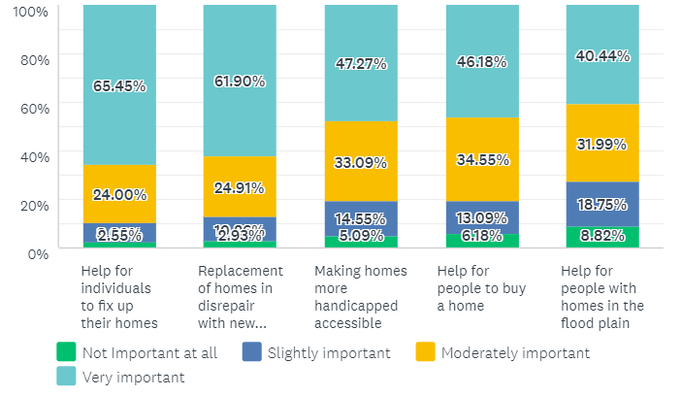
Programs that meet City’s homeownership needs
Washburn PPH
40%
35%
41%
55%
50%
30% fair
30% fair
56% rate it as good or excellent
76% rate it as good or excellent
31% fair
47% rate it as good or excellent
67% rate it as good or excellent
55.8% rate it as good or excellent
Majority of respondents think these programs are very important or moderately important. Helping individuals fix up their home was ranked number one, followed closely by replacing homes. This is the same as 5-years ago.
Notes:
Th

Slide 28
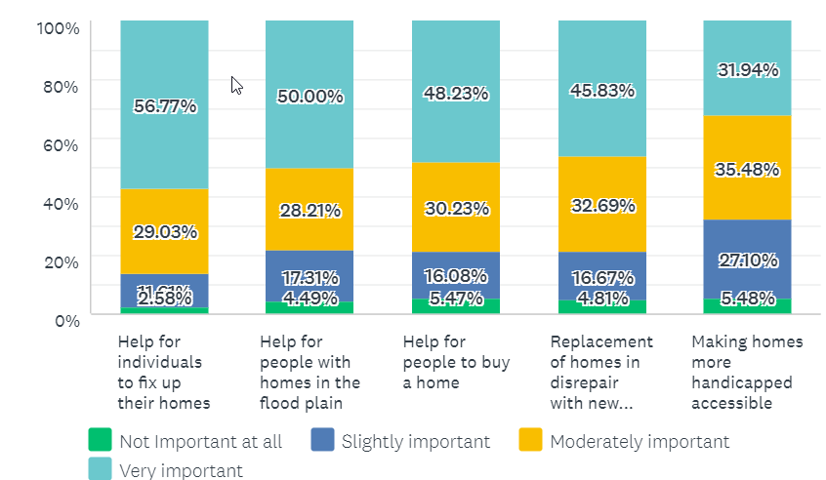
Northside
40%
35%
41%
55%
50%
30% fair
30% fair
56% rate it as good or excellent
76% rate it as good or excellent
31% fair
47% rate it as good or excellent
67% rate it as good or excellent
55.8% rate it as good or excellent
Much larger percentage of people interested in programs that help people fix up their existing homes and help for people with homes in the flood plain.
Notes:
Th

Slide 29
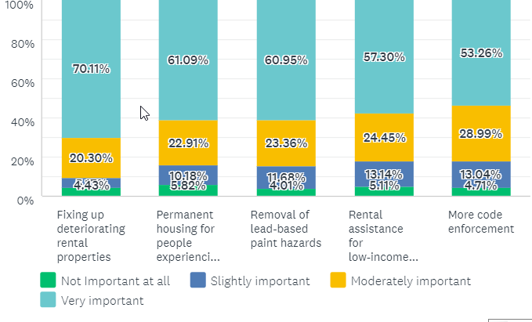
Programs that meet City’s rental needs – PPH/Washburn
48%
47%
51%
60%
52%

Slide 30
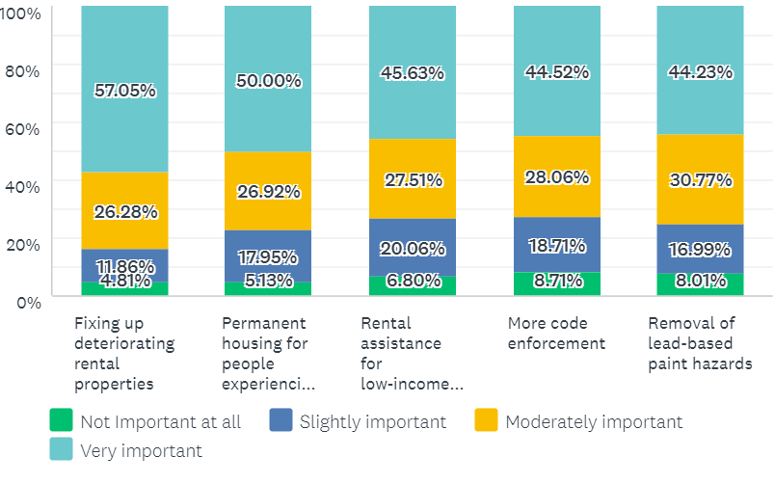
Programs that meet City’s rental needs- Northside
48%
47%
51%
60%
52%
Improving the quality of rental properties and permanent housing for the homeless very important. Rental assistance for low-income families also important.

Slide 31
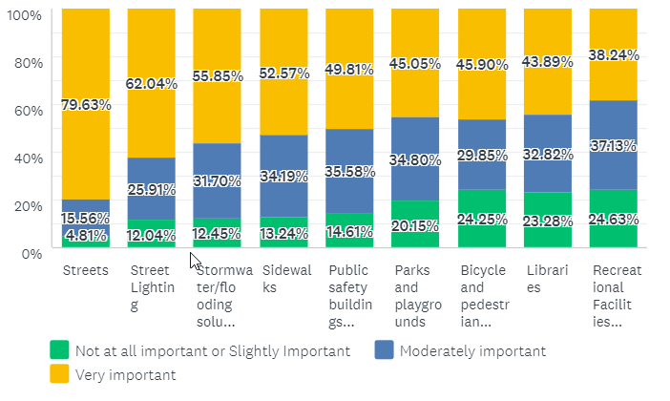
How important are the following capital improvements? PPH and Washburn
49%
47%
42%
42%
41%
32%
79%
55%
55%
Streets and street lighting very important. But addressing housing quality and housing affordability still seen as slightly more important than other capital improvements.
Notes:
Everything is generally more important than it was 5 years ago.

Slide 32
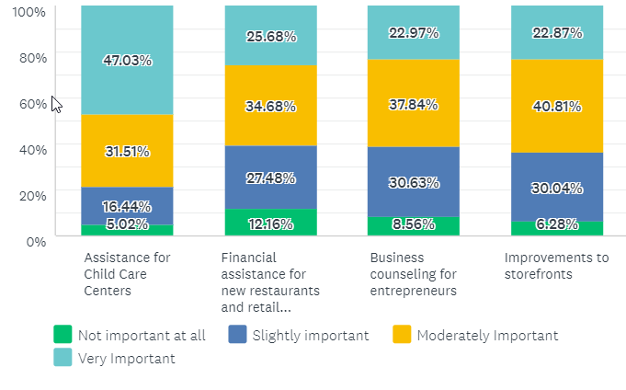
How important are these Economic Development programs?
New restaurants and retail, child care more important that City-wide survey
Significantly lower on the Northside (33%, 35%, 22%, 20%)
Notes:
Child care emerges as important and elsewhere in the City , 48% of low income individuals stated this was very important

Slide 33
All programs – Rank Ordered
PPH/Washburn
Streets (79%)
Fixing up deteriorating rental properties (72%)
Help for individuals to fix up their homes (65%)
Street lighting (62% PPH/W)
Replacement housing (62%)
Permanent housing for people experiencing homelessness (61%)
Removal of lead-based paint hazards (60%)
Rental assistance for low-moderate income families (57%)
Northside
Streets (77%)
Street Lighting (62%)
Stormwater/Flooding (57%)
Fixing up deteriorating rental properties (57%)
Help for individuals to fix up their homes (57%)
Permanent housing for people experiencing homelessness (50%)
Help for people with homes in the flood plain (50%)
Help for people to buy a home (48%)
Notes:
Caroline or Hetti?

Slide 34
PPH and Washburn
Four (4) types of services that City should prioritize
Notes:
Child care emerges as important and elsewhere in the City

Slide 35
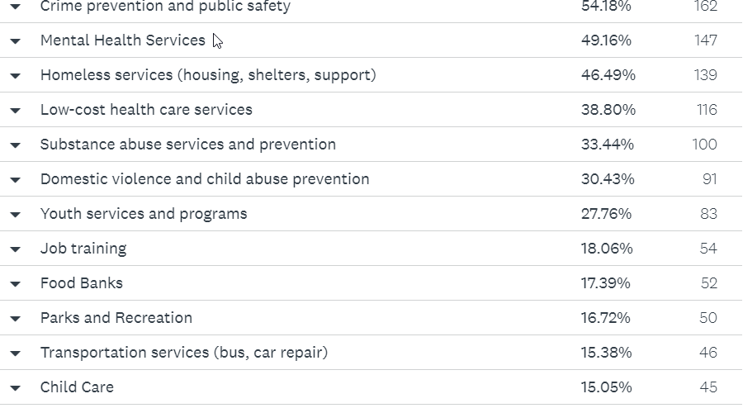
Northside
Notes:
Child care emerges as important and elsewhere in the City

Slide 36
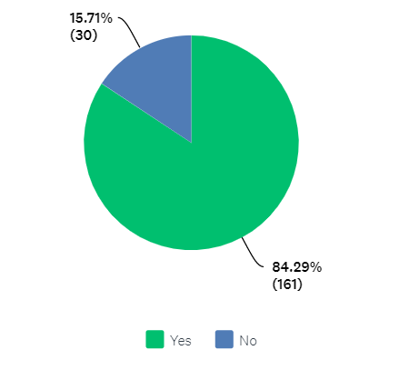
Would you support a strategy that targets resources to specific neighborhoods ?
City-wide 75% said yes
Notes:
Child care emerges as important and elsewhere in the City

Slide 37
Any final Comments?- PPH Washburn
Thank you
Do not redevelop the wasteful off-street parking lots which only serve the people from Holmen or Onalaska and don’t benefit the people of La Crosse
I feel disgusted when the City pours money into expanding places like the La Crosse Center and makes excuses for not taking care of streets, water issues, and the needs of children and poor families. I am also concerned about the drug trafficking in my neighborhood and in the 6 years I've lived here, have not noticed a change except for an increase.
STOP trying to separate AODA and Mental Health issues. They cannot be!
Better senior centers
Bicycle Lanes
Improved food access
Thank you
Thanks for fixing up my neighborhood. I live there so I can walk to work. It's great.
We need real bike paths not bikes printed on roads.
lighting, new roads, get rid of the bicycles & put them in their own lane
We need to crack down on absentee landlords. Many of these properties are devaluing our neighborhoods. We also need to enforce current housing ordinances.
Would like to see the alley paved.
need lighting hood street 6th and 7th. small grocery store on farnam and hood.
More infrastructure services like housing stock improvement / affordability, public transportation expansion, and promotion of neighborhood grocery stores, dog parks, and community kiosks.

Slide 38
Any final Comments?- PPH Washburn
I think the city is doing a great job as a whole. Moving forward I think looking at specific programs that deal with section 8 housing, homelessness, and drug prevention (the needle exchange) and figuring out which programs are actually helping individuals or if they are enabling people to continue their ways that make our community an unsafe and unappealing place to live is important. (i e homeless in the parks, children being stuck with free needles in the parks and providing money to those who abuse the system). La Crosse used to be an amazing place to live and while it still is a "nice" place to live I feel the choices we are making are slowly deteriorating our lovely and once safe community. PS. Can you please post a survey about our judges! ;)
Washburn neighborhood needs a lot of help. Some people have invested heavily into the neighborhood but they need support and more action from the City to continue to revitalize with single family and clean up the crime
If you want anyone to want to live and work here, or desire La Crosse to be a travel destination, THE ROADS NEED TO BE FIXED.
Bathrooms in City, rehab Shopko into affordable, tiny apartments, look at unused land for housing, all city trees should have food available, where sidewalks are underutilized- transform them into bike lanes (like near Walmart). Good luck.
Help the elderly take care of their homes and more affordable housing for Seniors
I love this city. I am appalled that their housing is so awful. Do better, and let me know what, as a citizen and resident of La Crosse, WI I can do to help. No one should have to live in houses with poor foundations and pest problems. Rental properties need to be better, and I feel that there should be ramifications for landlords
Renters need to be able to challenge landlords and the way they mistreat tenants
A lot of things were done in the name of savings that harmed the City long term- cuts to the number of locally experienced police officers with relationships. We need young families to maintain our labor pool. Libraries should be supported.
More trees, less cutting down of trees

Slide 39
Any final Comments?- PPH/Washburn
Making all parts of La Crosse more family friendly. More higher end restaurants and bars
La Crosse Street needs to be fixed
Developing more homeownership and more reinvestment in existing housing
Mixed income neighborhoods
Continue to fight against blight in our poorest neighborhoods
Police and community relationships
Property assessments
Enforcement for landlords who do not manage their property
Buy dilapidated rentals and build new
Fix the roads
Nicer dog park
I love la crosse and want it to grew. I just might have to leave if I cant find a good apartment to live in.
The rental situation in this city is disgusting, my home was growing mushrooms in the hallway
More money on roads, parks, schools, libraries, lights
More stuff for low income children
Abesentee landlords, enforce housing ordinances

Slide 40
Any final Comments?- Northside
I live in a property and the landlord does not care. They (landlord) stopped maintaining my furnace. My furnace operates at less than 80% efficiency.
I love La Crosse and would like to continue to be a resident, but find myself sometimes looking elsewhere to live due to being priced out of quality housing. The DART team has played a major role in my relatives life this last year and I am thankful for these programs! I also love the focus of inclusivity of all cultures within our community and schools
substance abuse assistance - Gundersen has 2 year wait and Mayo closed
Crosswalk at Livingston
Maintain Northside Senior Center, Senior Centers
New lighting on Avon St are excellent, I wish there was more Lighting on the Northside
Easier access to the La Crosse Public Housing Authority
There needs to be stricter rules and regulations for landlords. Need better tenant screening.
More homes and apartments for working class families
Focus on rebuilding homes in the flood plain and more emphasis on Senior living housing
More health and educational support
Northside needs developing
Child care options and fair pricing
More substance abuse resources
Push out bad landlord and tear down dilapidated homes for new development. All rentals should be inspected.
Stop taxing property owners
Rents are too high in La Crosse, $850 or higher for rents is not affordable.

Slide 41
Any final Comments?-Northside
More focus on Northside low income families
Street lighting at 2700 block of prospect st
Help people to be aware of all the assistance out there
Biggest problems are the roads
Rein in the slum lords around the college. Fix the roads.
Sidewalk repair along 200 rose St.
The empty retail space from Shopko and KMart leaving needs to be fulfilled. Either something to draw in visitors, or housing. Keeping a positive energy going is what makes La Crosse a great city to live in. The Mayors Conference showed and demonstrated the commitment of our leaders. I applauded them all and say thank you with great gratitude of making La Crosse a great place to live.
More building erected to help people with mental health problems
I don't like the idea of pitting neighborhoods against one another. I agree that some neighborhoods need more work, but that's why we have City Hall and its staff - to determine where the needs are, and target projects, not neighborhoods, The creation of all the neighborhood associations and new identities simply created a shadow government, letting City Hall shift blame, if convenient. I don't wish to empower these groups further. Can the Council members not represent their neighborhoods??

Slide 42
Any final Comments?- Northside
Parents need more input on our schools. Coaches are being protected When engaging in verbal abuse to kids. Teachers do not have enough say and enforcing discipline in the schools
Use the Flood Plain Grant to actually help people get out of the flood Plain. Instead of Spouting off that there are all these funds but no one has been utilizing them. Get a Flood Plain manager who can focus on the issues
We need to make this more of a community again. The city is losing it hometown appeal. It needs to look better and we need to address the homeless and drug problems. We need to have more places for the homeless to go during the winter months especially. I know that Catholic Charities fills up quickly as well as does the Salvation Army. We need to make the neighborhoods safer. More lighting, and more patrols. We moved into this rental in 2001, since that time we have watched the neighborhood deteriorate, and the crime go way up.

Slide 43
Key Takeaways
Significant improvements have been made in all key areas identified 5+ years ago (more policing, housing investment, parks)
General trend is positive for the neighborhood (feeling from long-time residents)
Somewhat depends on what block you live on
More needs to be done in the area of housing and policing, neighborhood commercial, roads
Door-to-door a good way of assessing needs
I spoke to a few Promise families who are deeply dissatisfied with the neighborhood (3)

Slide 44
What’s next for the survey results?
Inform Council of the importance of roads but maintain focus on things we (Community Development) do well and can leveraging resources- housing quality and affordability
Recommend to Parks and Recreation to consider how to improve community engagement in projects
Share results with police department
Preliminary Ideas for 5-Year CDBG Plan
Continue replacement housing in the neighborhood (but concern that there are now limited funds)
Support child care, upgrades to Hamilton School
Prioritize supporting businesses that are food-related
Continue to examine how to improve quality of housing stock through incentives and enforcement
Deeper affordability for “new” affordable housing
Examine connections to waterfront and bike/pedestrian improvements

Slide 45
What are your thoughts?
Based on the survey, where do you think the City should prioritize its funds?

